Slide 1
The Physical Therapy Profession
Month DD, YYYY
Name or Location [Arial 20pt, White]

Slide 2


Slide 3
Introduction to Physical Therapy
Notes:
Today you’ll learn more about the profession of physical therapy and why it is a great career option for you to consider. Let’s start with the basics.

Slide 4
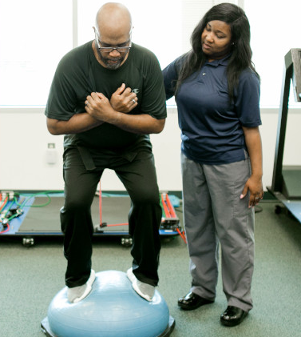
Physical therapy is treatment provided by a physical therapist or physical therapist assistant that helps people improve their movement and physical function, manage pain and other chronic conditions, and recover from and prevent injury and chronic disease.
Notes:
What is physical therapy? Here is a formal definition, but, in short, physical therapy helps people move better. It helps improve movement and physical function to prevent and/or treat injury and chronic disease.
Big picture: Physical therapy is vital because it keeps people moving, and movement is one of the keys to life. Think about how your life would change if you couldn’t move or your mobility was limited in a way you are not used to.
Movement doesn’t refer just to running and dancing; we’re also talking about sitting and standing, walking, playing, bathing, breathing, even keeping lymph moving through your body. Physical therapists help keep people moving so they can live life to the fullest.

Slide 5
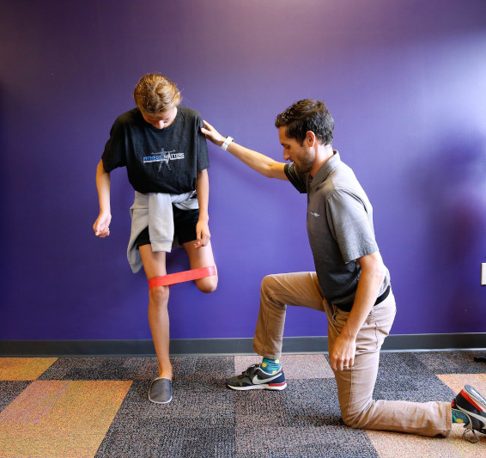
Physical Therapists Are Movement Experts
Licensed doctors who examine, diagnose, and treat movement dysfunction.
Help people impacted by disease, injury, and disability.
Prevent movement loss and promote wellness.
Use therapeutic exercise, modalities, assistive devices, patient education, and evidence-based research to treat patients.
Notes:
Physical therapists are licensed health care providers who help people move better. They are educated with a professional doctoral degree and trained to examine, diagnose, and treat movement dysfunction, as well as to optimize movement function.
They are anatomy and physiology experts. Physical therapists have an in-depth knowledge of the body’s muscles, bones, nerves, ligaments, tendons, blood vessels, fascia, etc., and how they all work together to keep people moving.
Physical therapists use movement, exercise, modalities, and techniques such as heat, cold, electrical stimulation, manual therapy, and light therapy to treat movement dysfunction and prevent injury.

Slide 6

Physical Therapist Assistants Collaborate With PTs
Educated and licensed or certified clinicians.
Provide physical therapy services under the direction and supervision of a licensed physical therapist.
Implement components of patient care, obtain data related to the treatments provided, and collaborate with physical therapists to modify care, as necessary.
Physical therapist assistants are not the same as physical therapy aides.
Notes:
Physical therapist assistants are licensed or certified clinicians that provide physical therapist services under the direction and supervision of a licensed physical therapist.
Physical therapist assistants are not trained to examine and diagnose as physical therapist are, but they are trained to assist with the implementation of patient care and treatment.
There is a difference between physical therapist assistants and physical therapy aides. PTAs are licensed or certified clinicians trained to provide health care services, while physical therapy aides perform nonmedical tasks and assist with clinic duties, working under the supervision of PTs and PTAs.

Slide 7
Physical Therapy Education
Notes:
Let’s look into a quick overview of what it takes to become a physical therapist or physical therapist assistant.

Slide 8
There Are Two Physical Therapy Career Pathways
Pathway to DPT
High school diploma or GED
Bachelor’s degree
Three-year DPT degree*
DPT licensure exam
* Some DPT programs offer freshman entry
Pathway to PTA
High school diploma or GED
Two-year associate degree
PTA licensure exam
Notes:
There are two pathways you can choose to enter the profession of physical therapy.
You can be a physical therapist or physical therapist assistant. Both career pathways work with patients. However, as mentioned before, physical therapists are trained to examine, diagnose, and treat patients, while physical therapist assistants are trained to assist physical therapists with patient treatment. Physical therapists must obtain a bachelor’s degree and then a three-year clinical doctor of physical therapy degree. Physical therapist assistants must obtain a two-year associate degree.

Slide 9
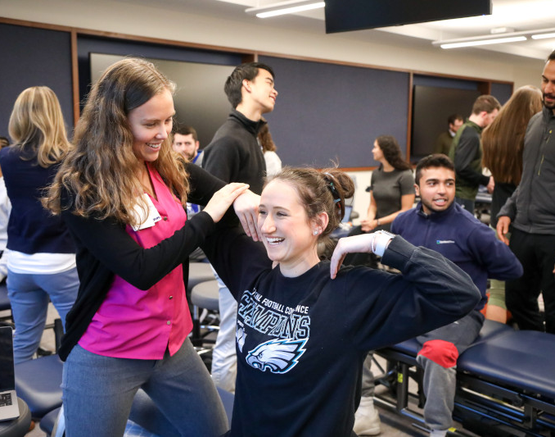
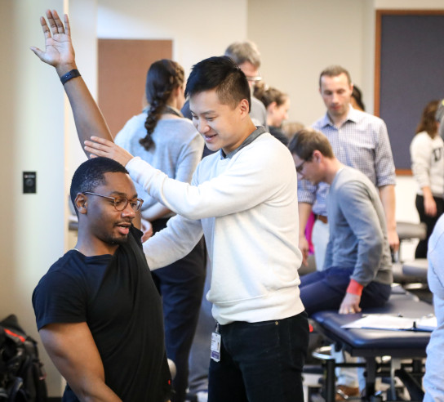

Pathway to DPT
High school diploma or GED
Bachelor’s degree
Three-year DPT degree*
DPT licensure exam
* Some DPT programs offer freshman entry
Notes:
To be a physical therapist you must complete a professional doctor of physical therapy degree from a CAPTE-accredited physical therapist program. Upon completion of the DPT program, you’ll take the National Physical Therapy Examination for PTs.

Slide 10
DPT Education
Time Commitment
Bachelor’s degree
(~4 years)
3-year DPT program
Preparation
Strong science background
Understanding of the profession (www.apta.org)
Applying
PTCAS
Application opens in July
Curriculum
Degree
Clinical
Didactic/Lab
NPTE licensure exam
Doctor of physical therapy degree
Notes:
Time Commitment:
To enter a DPT program you must obtain a bachelor’s degree, then most DPT programs take three years to complete. However, there are some freshman-entry programs.
Preparation:
The DPT program curriculum is heavy on basic science, so having a strong science foundation is helpful (biology, chemistry, physics, anatomy, physiology, biomechanics, etc.). You also want to make sure you have a good understanding of the profession and what physical therapists do. You can do this can by shadowing a PT, volunteering, finding a PT or PT student mentor, and looking at the APTA website (www.apta.org), among other things.
Applying:
Most DPT programs require prerequisite courses, PT observation hours, and letters of recommendation as part of their application process. Also, 95% of DPT programs require applicants to apply via the Physical Therapy Centralized Application Service. You can visit www.PTCAS.org for more detailed application information, requirements, average GPAs, and more.
Curriculum:
Most DPT programs have a combination of didactic/classroom, lab, and clinical coursework. In additional to classroom learning you will have intensive anatomy and physiology courses and labs and be required to complete clinical rotations.
Degree:
Upon completion of a DPT program you will obtain a doctor of physical therapy degree, and when you pass the National Physical Therapy Examination you will become a licensed physical therapist.

Slide 11
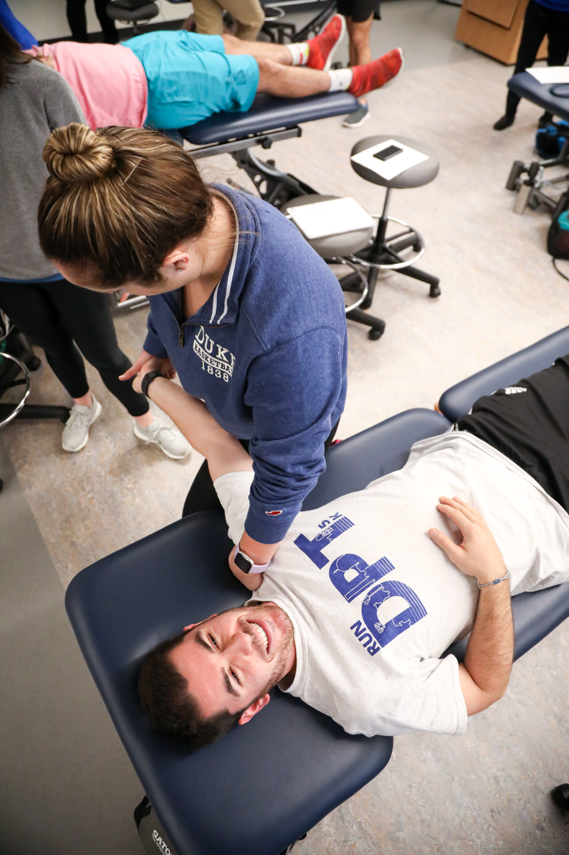
Primary Content Areas in DPT Curriculum
Biology
Anatomy/physiology
Cellular histology
Exercise physiology
Biomechanics/kinesiology
Neuroscience
Pharmacology/pathology
Ethics/values
Management sciences
Communication
Sociology/behavioral sciences
Clinical reasoning
Evidence-based practice
Cardiovascular and pulmonary
Endocrine and metabolic
Musculoskeletal
Notes:
These are some examples of a few content areas covered in a DPT program curriculum. As you can see, it’s a mixture of science and humanities. You do need a strong science foundation, but it’s also important to know how to communicate and empathize with your patients, have strong ethical values, etc.

Slide 12
Prerequisite Courses
GRE
Observation Hours
Letters of Recommendation
Supplemental Application
www.PTCAS.org
Common DPT Application Requirements
Notes:
Prerequisite Courses:
Common prerequisite course requirements include anatomy, physiology, biology, chemistry, physics, and statistics.
GRE:
Some but not all DPT programs require the GRE as part of their application process.
Observation Hours:
94% of DPT programs using PTCAS require or highly recommend observation hours with a licensed physical therapist.
Letters of Recommendation:
Most DPT programs require or recommend submission of one or more letters of recommendation from a physical therapist, professor, supervisor or employer, teaching assistant, physical therapist assistant, advisor, etc.
Supplemental Application:
In addition to submitting the PTCAS application, about 35% of DPT programs require a supplemental application as well.
PTCAS:
More information about application requirements can be found on www.PTCAS.org, where you can visit individual program pages to learn more or look at comparisons of program requirements.

Slide 13
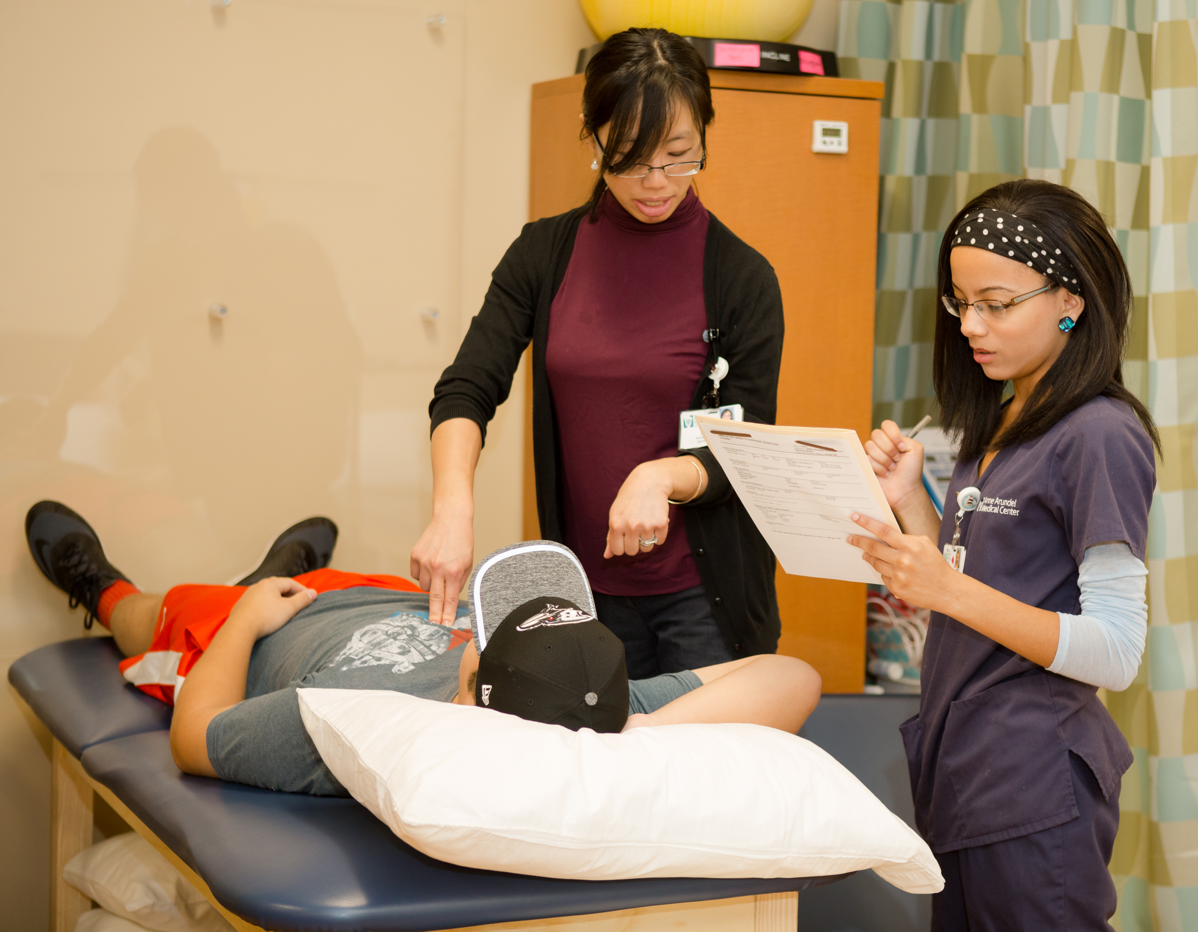
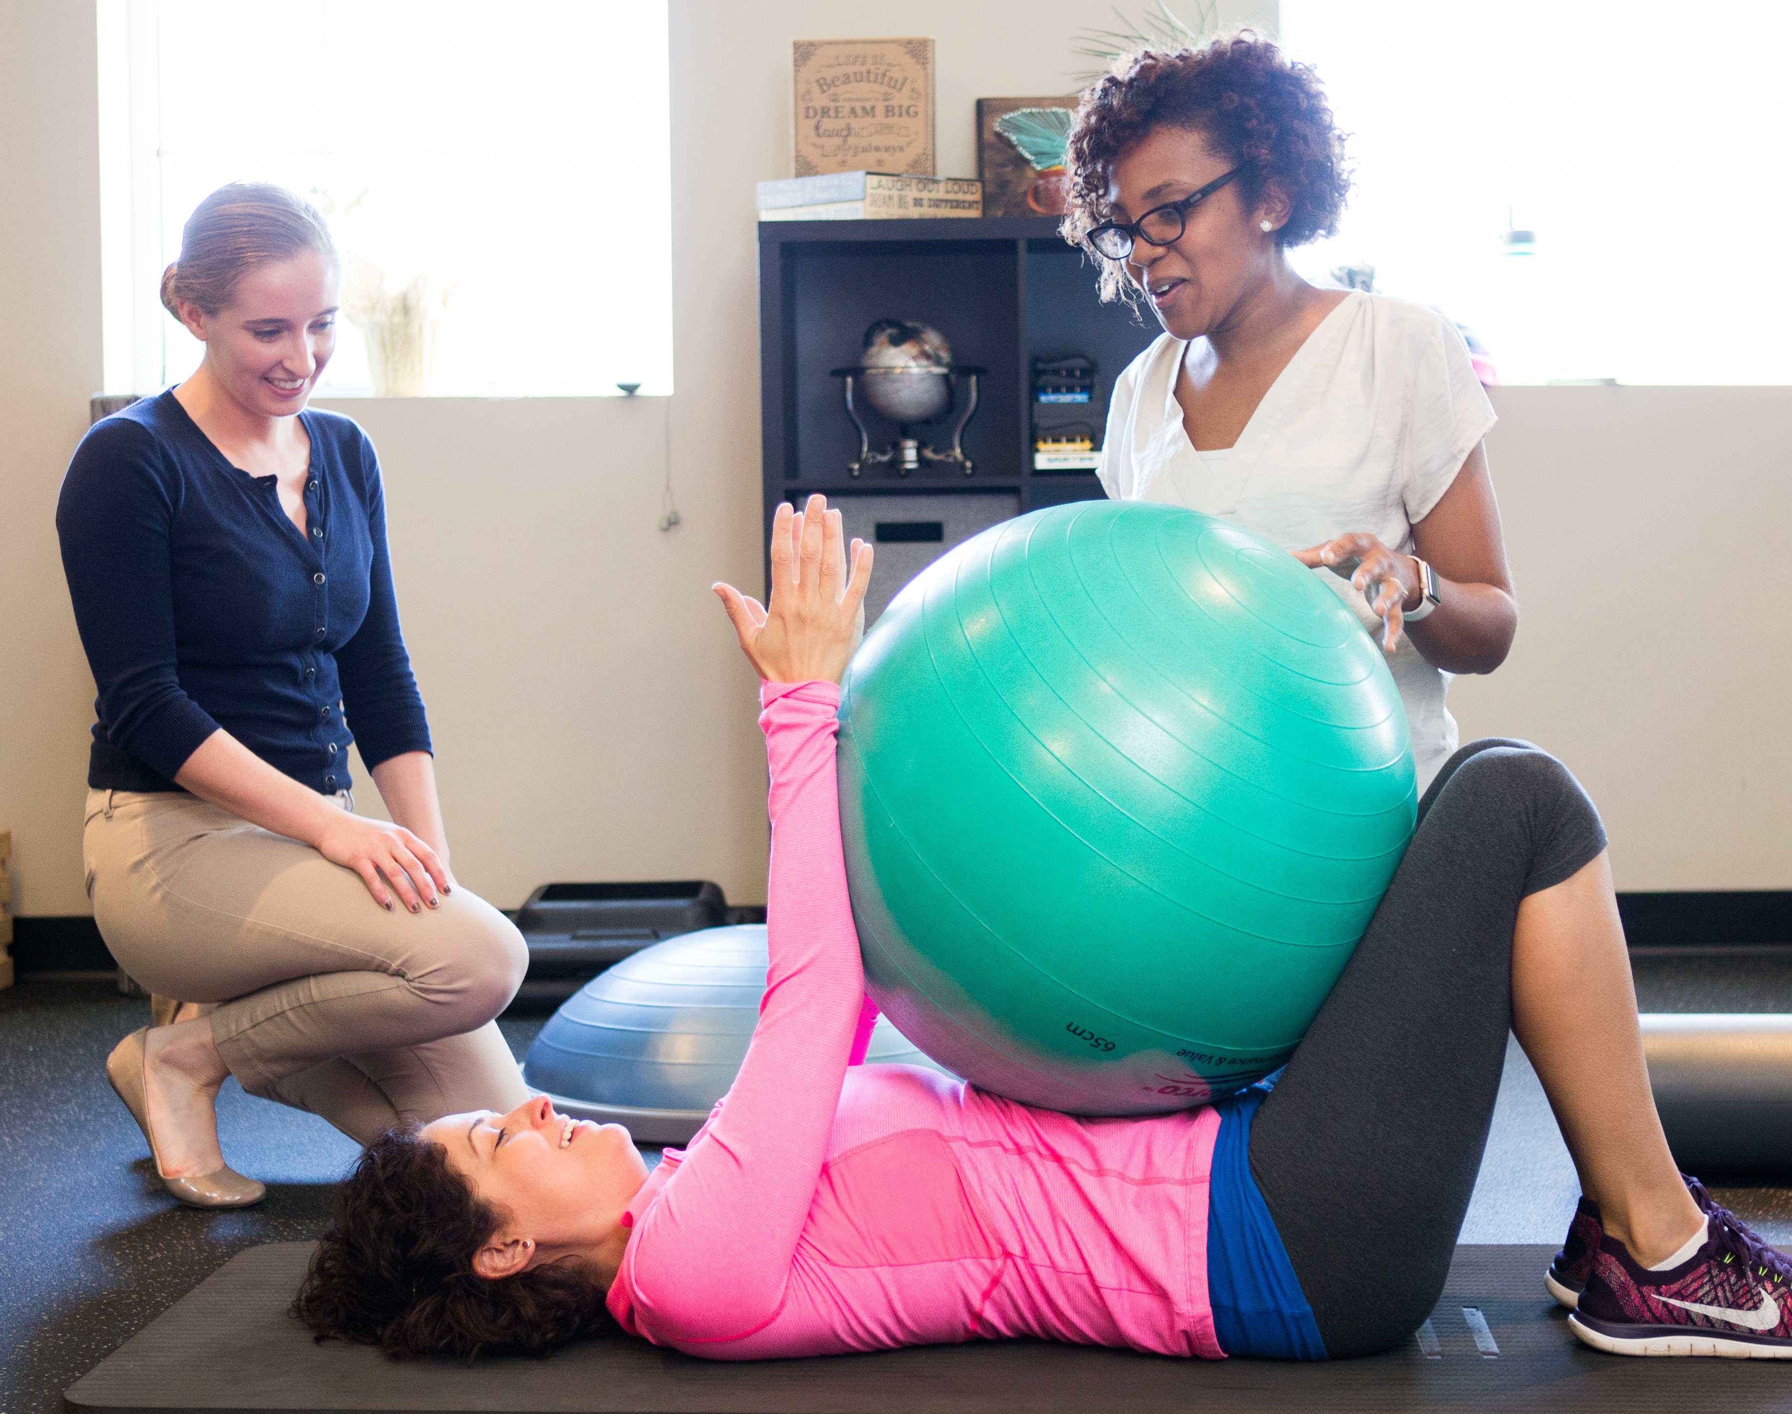

Pathway to PTA
High school diploma or GED
Two-year associate degree
PTA licensure exam
Notes:
To be a physical therapist assistant you must complete a two-year associate degree from a CAPTE-accredited physical therapist assistant program. Upon completion of the program, you’ll take the National Physical Therapy Examination for PTAs.

Slide 14
PTA Education
Time Commitment
High School
2-year PTA program
Preparation
Science background
Understanding of profession
Applying
Research programs (CAPTE)
Individual program applications
Curriculum
Degree
Clinical
Didactic/lab
Licensure exam / certification
Associate degree
Notes:
Time Commitment:
To enter a PTA program you must obtain a high school diploma or GED. Most PTA programs take two years to complete. However, some programs will accept transfer credits, so it could take less than two years.
Preparation:
To prepare for PTA program application, you also want to have a good understanding of anatomy and physiology. You also want to make sure you have a good understanding of the profession and what physical therapist assistants do. You can do this by shadowing a PT or PTA, volunteering, finding a PTA or PTA student mentor, and by looking at the APTA website (www.apta.org), among other things.
Applying:
Some PTA programs require prerequisite courses, physical therapy observation hours,and letters of recommendation as part of their application process.
In order to apply for PTA programs, you will apply directly to your desired institution. Each program will have individual program applications so please refer to their application in regards to what they want. CAPTE provides a list of all PTA programs around the country.
Curriculum:
PTA programs have a combination of didactic/classroom, lab, and clinical coursework.
Degree:
Upon completion of a PTA program, you will obtain an associate degree, and when you pass the National Physical Therapy Examination you will become a licensed physical therapist assistant.

Slide 15
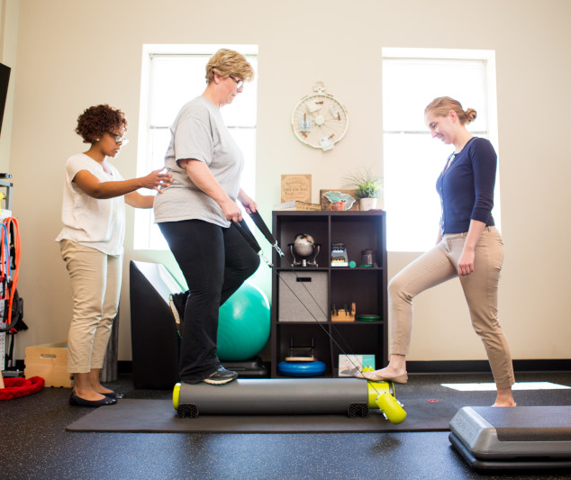
Some Primary Content Areas in PTA Curriculum
Anatomy/physiology
Exercise physiology
Biomechanics
Kinesiology
Neuroscience
Clinical pathology
Ethics/values
Behavioral sciences
Notes:
These are some examples of a few content areas covered in a PTA program curriculum. Again, you’ll see science and humanities courses included. PTs and PTAs spend more time with patients than most other health professions, so possessing strong communication, ethical, and behavioral skills is as important as possessing clinical skills.

Slide 16
Prerequisite Course(s)
Observation Hours
Letters of Recommendation
Official Transcripts
Application Fees/Fee Waiver
www.APTA.org or www.CAPTEonline.org
Common PTA Application Requirements
Notes:
Prerequisite Courses:
Common prerequisite course requirements include anatomy, physiology, and English.
Observation Hours: Some PTA programs might require observation hours prior to admission. Some will require hours in a specific setting or population.
Letters of Recommendation: Some PTA program require applicants to submit letters of recommendation from a physical therapists, a physical therapist assistant, etc.
Official Transcripts: All official transcripts from post secondary institutions and from your graduating high school are required.
Application Fees/Fee Waivers: Some programs require application fee, but if applying via PTACAS applicant can apply to receive a fee waiver which will waive the application fee for the first PTA program they apply.
APTA/CAPTE: visit www.APTA.org for more information or www.CAPTEonline.org to for a list of accredited PTA programs around the country.

Slide 17
General Application Tips
Do not …
Do …
Wait until the deadline to apply.
Submit incorrect information.
Take a passive approach to the application process.
Apply early.
Stay organized.
Pay attention to detail.
Be proactive and specific.
Notes:
When preparing to applying to DPT or PTA programs, keep in mind some general application tips:
Most programs will list a deadline date, but this is just the last date they will accept applications. Depending on how the application process is organized, the longer you wait the less your chance of being accepted. It is always recommended to apply early. If possible, submit your application one month before the deadline. Deadlines are posted on www.ptcas.org and on the program’s site.
There are a lot of similar application requirements between DPT programs; however, there are differences in application requirements. For example, two different programs might both require anatomy and physiology, but one might require the course to have been taken in the biology department while the other program might accept courses from either the biology or kinesiology department. Some programs require three letters of recommendation and others require two. It’s important to pay attention to all the details when starting your application preparation process. Start by visiting ptcas.org or ptacas.org and the programs’ websites. Also feel free to call or email programs directly if you have specific questions. Find a way to stay organized throughout this process. Make spreadsheets, folders, or whatever you need to remain organized from start to finish. This is a process in which the details matter.
Don’t wait for people to tell you what you need to be a successful applicant. Do you own research, ask questions, and seek out information from people who can accurately advise you. Again, visit ptcas.org or ptacas.org and each program’s website first. Call or email programs directly if you still have specific questions. Once you submit your application, make sure the school receives it and the proper information is there. You can check your application status on PTCAS, and if you have questions you can email or call the PTCAS or PTACAS support line or the program directly.

Slide 18
Professional Opportunities
Notes:
The first step to becoming a PT or PTA is being accepted to a DPT or PTA program, but once you are accepted there are various professional opportunities to pursue.

Slide 19
DPT Professional Opportunities
Residency
Board Certified Specialist
Fellowship
Clinical instructor credential
Leadership development
Postprofessional degree
Notes:
Residency:
A residency program is a postprofessional planned learning experience comprising a curriculum that encompasses the essential knowledge, skills, and responsibilities of an advanced physical therapist within a defined area of practice. Residency programs prepare physical therapists with the requisite knowledge and skill set needed to pass the certification examination following graduation from the program. (See more at abptrfe.org/ForParticipants/AboutResidencies.)
Board Certification:
Certified by the American Board of Physical Therapy Specialties following a board exam, board-certified clinical specialists have demonstrated advanced clinical knowledge and skills in one or more of 10 physical therapy specialty areas.
Fellowship:
A fellowship is a postprofessional planned learning experience comprising a curriculum that encompasses the essential knowledge, skills, and responsibilities of an advanced physical therapist within a defined area of subspecialty practice. (See more at abptrfe.org/ForParticipants/AboutFellowships.)
Credentialed Clinical Instructor Program:
This program enhances clinical instruction education for PTs and PTAs interested or involved in clinical education.
(See more at apta.org/CCIP.)
Leadership Development:
The APTA Fellowship in Education Leadership provides skills and resources needed to be an innovated and influential leader.
Postprofessional Degree:
In addition to PTs earning a clinical doctor of physical therapy degree or PTAs earning an associate degree, some also go on to attain other degrees, such as a PhD, MPH, or MBA.

Slide 20
As a Physical Therapist You Can Be a ….
Clinical practitioner.
Board-certified specialist.
PT resident.
PT fellow.
Professor/program director.
Researcher.
Professional advocate.
APTA staff/CEO/Board member.
Travel PT.
Entrepreneur.
Influencer.
More …
Notes:
As a physical therapist you will be a trained clinician; however, there are multiple pathways you can choose within this profession. You can be a general practitioner, a specialist, researcher, professor/clinical educator, advocate, entrepreneur, CEO, board member, and more. Or a combination of these things.
So, in addition to treating patients, there are other professional opportunities available to you as a physical therapist.

Slide 21
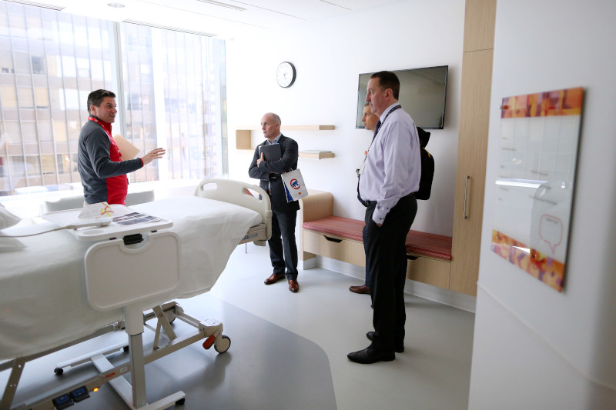
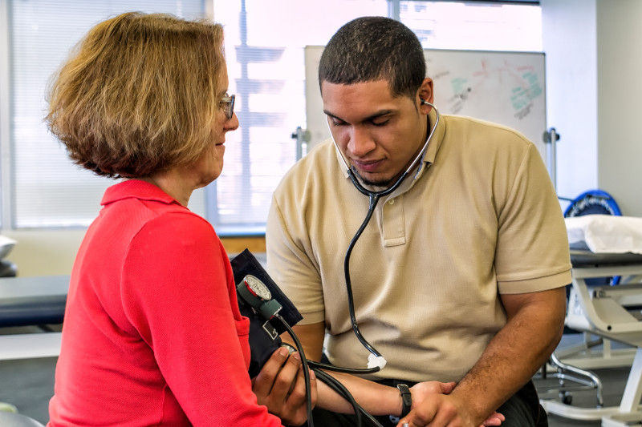
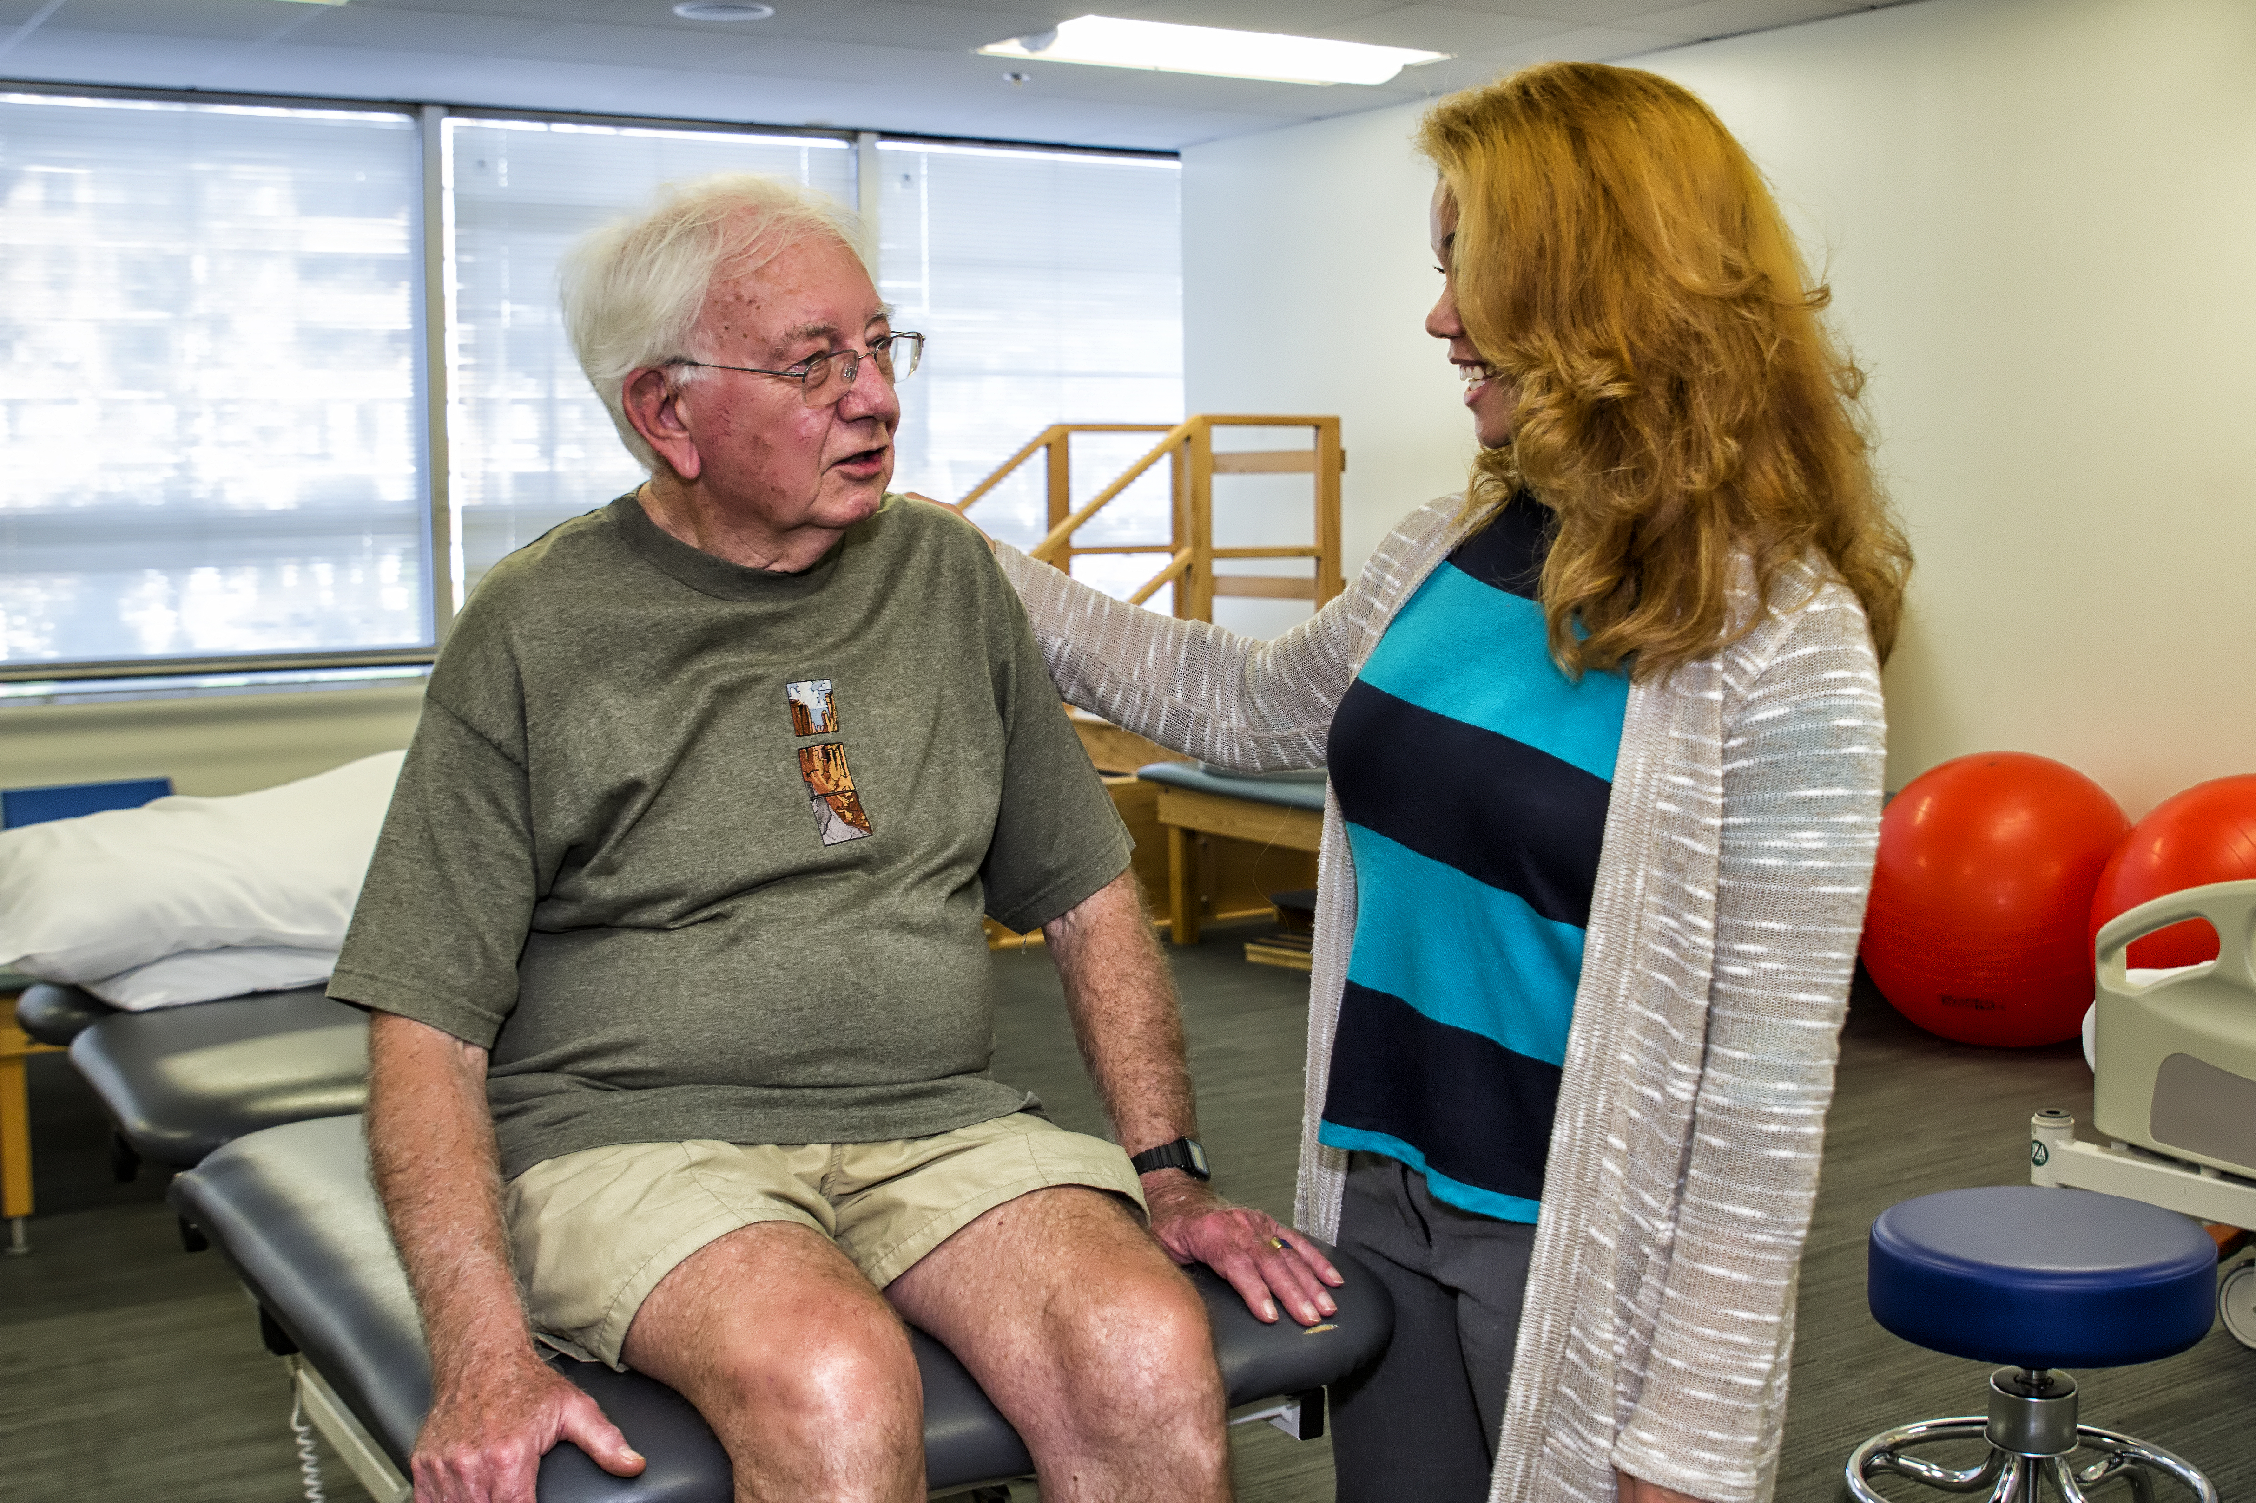
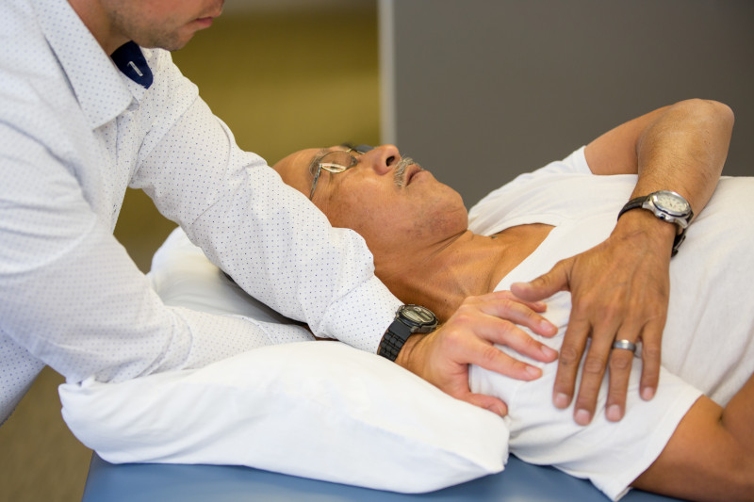


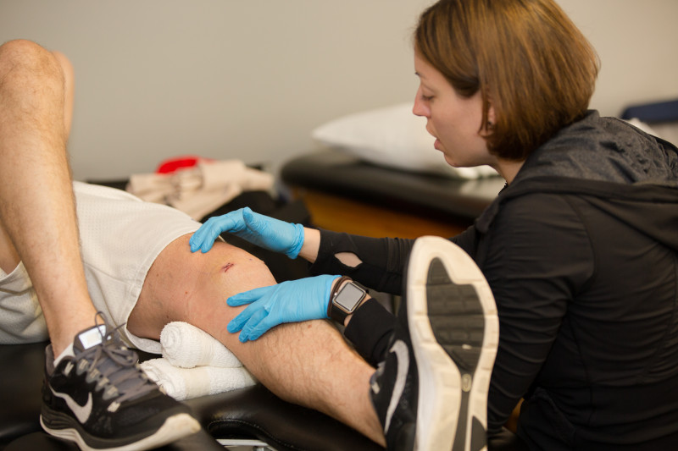
PTA Career Development - Advanced Proficiency Pathway Program
Acute Care
Cardio/Pulmonary
Geriatrics
Orthopedics
Oncology
Pediatrics
Wound Management
Notes:
The APTA PTA Advance Proficiency Pathways program was developed to increase a PTA’s knowledge and skill in a chosen area of physical therapy. Once achieved, Advanced Proficiency Pathway recognition is good for 10 years.
(See more at apta.org/for-ptas/pta-advanced-proficiency-pathways.)

Slide 22
Why Choose Physical Therapy?
Notes:
There are multiple career options, even within health care, but why should you choose the profession of physical therapy?

Slide 23

Movement Is Essential to Life
PTs and PTAs optimize quality of life by focusing on movement loss prevention and optimal movement performance.
Notes:
If you love anatomy, physiology, muscle movement, and exercise, and you’re curious about human body movement in general, then physical therapy is a great career option. Physical therapists and physical therapist assistants do more than help keep people moving — in some instances they help people regain their life.

Slide 24

Boston Marathon bombing survivor Adrianne Haslet thought her quality of life would be a zero. Her physical therapist and the rest of her health care team helped Adrianne to move and to believe again.

Slide 25
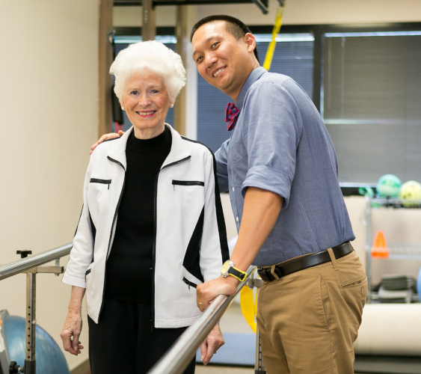
PT is a Personally, Professionally, and Financially Rewarding Career!
Top-ranked health care profession
Growing profession; 14% increase (PT) in 2022-2023
2023 Median salaries: $99,710 (PT) and $58,740 (PTA)
Fosters relationships with patients
Allows you to see the direct impact and benefit of your work
Notes:
In addition to helping people regain their quality of life:
1. Physical therapy is consistently ranked as one of the top health professions.
Top Ranked Profession (https://money.usnews.com/careers/best-jobs/physical-therapist)
#10 in Best Healthcare Jobs
#15 in 100 Best Jobs
2. It’s a profession that is predicted to continue to grow. People are living longer and want to keep moving on their own as much as possible. Physical therapists are needed.
Cited by U.S. Bureau of Labor Statistics under Job Outlook (https://www.bls.gov/ooh/healthcare/physical-therapists.htm#:~:text=Employment%20of%20physical%20therapists%20is,the%20average%20for%20all%20occupations.&text=In%20addition%2C%20physical%20therapists%20will,such%20as%20diabetes%20or%20obesity)
3. Salary levels are strong. Median PT salary is $89,440 (https://www.bls.gov/oes/current/oes291123.htm). Median PTA salary is $58,520 (https://www.bls.gov/oes/current/oes312021.htm)
4. Physical therapy fosters relationships with patients. Physical therapists on average spend more time with their patients than other health professions do, with 30- to 60-minute appointment times and potential multiple visits that could continues for weeks, months, and maybe even years, depending on the patient’s needs and goals.
5. It is likely that you’ll be able to witness your patient’s progress over time, allowing you to see the physical impact of your work.

Slide 26
What You Can Do Now
Notes:
What can you do now to start preparing for a future in physical therapy?

Slide 27
Do your research
Observe a PT or PTA
Start
Preparing
Now!
Diversify your experience
Find a mentor
Review anatomy and physiology
Build a strong science foundation
Notes:
1. Do your research: Visit www.apta.org, www.ptcas.org, and individual programs.
2. Shadow or observe a PT or PTA to see what it’s like up close.
3. Diversify your experience: If possible, observe more than one or two days, in a variety of settings, and with a variety of patient populations. An experience in an outpatient orthopedic clinic will be different from an inpatient burn unit or a cardio/pulmonary clinic.
4. Find a mentor: Reach out to a local PT, PTA, or student PT or PTA who is willing to share their experience and guide you through the process.
5. Review anatomy and physiology: PTs are movement experts, and movement is based on understanding how muscles, bones, nerves, blood vessels, and other parts of the body work together to create movement.
6. Build a strong science foundation: Science courses such as biology, chemistry, and physics are required to enter physical therapy school. Anything you can do to ensure a solid foundation in these courses will be helpful.

Slide 28
Resources

Slide 29

APTA Helpful Resources
American Physical Therapy Association (APTA)
apta.org
Physical Therapist Centralized Application Service (PTCAS)
ptcas.org
Commission on Accreditation in Physical Therapy Education (CAPTE)
capteonline.org
APTA Free Financial Literacy Resource
moneysmart.ptmovesme.org/
Questions about PT Careers or Pathway to PT/PTA
studentrecruitment@apta.org

Slide 30




Stay Connected
@APTAPics
@APTATweets
@ChoosePTVideos
@AmericanPhysicalTherapyAssociation

Slide 31
Questions & Answers

Slide 32

APTA Financial Resources
https://moneysmart.ptmovesme.org/
Create a free account and learn important financial skills
National scholarship portal

Slide 33
Thank You

