Slide 1
Physical Therapy Moves Me!
Grade 3-5 Presentation
Notes:
Things to Think About:
When speaking with this age group (third to fifth graders), the goal is to light a spark in their mind about the profession of physical therapy. This presentation will not focus on the specifics of the profession; instead, it will focus on engaging the audience while providing high-level information about the profession.
When possible, try to relate what you are talking about back to your audience to help them connect with it personally. A great way to do this is by asking questions. For example: “Have your or anyone in your family ever seen a physical therapist?” ”Have you ever fallen and hurt yourself and could not move like you wanted to?”
If you are using the Grade 3-5 PowerPoint along with these talking points you will see the slides that ask them to think about their movement, depict the body systems of children, and name movement activities incorporated with the body system. Think of it as trying to get them to learn while moving and having fun, engaged learning.

Slide 2

Notes:
Welcome.
Introduce yourself and give the reason for your presentation.
Explain what you hope to achieve by the end of the presentation. For example, “By the end of this presentation I want you have a better understanding of how PTs and PTAs help people move.”

Slide 3
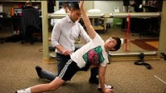
Notes:
This video shows Mac, who had a shoulder injury in the middle of his baseball season, working with his physical therapist to recover and get back on the field to play in the state tournament.
This slide is a visual aid to help the audience see how physical therapy can have a positive impact on people’s lives. This age group is usually very visual, so hopefully it will help them connect to the rest of the presentation.
If you want to find another video, visit ChoosePT’s YouTube Page. If you are a PT Moves Me Ambassador, you can find more videos on the PT Moves Me Ambassador Hub Community under the Recruitment Resources File Library.

Slide 4

What Are Some Things You Do That Require Movement?
Notes:
Start with a conversation to engage your audience and get them thinking about movement.
Try to get them to think beyond the obvious of walking, running, etc., to activities such as breathing, heart beating, swallowing, writing, and chewing. This will help them understand that movement involves multiple systems of the body, and PTs and PTAs treat and/or work with all those systems.
Help your audience to understand how essential movement is to life.

Slide 5
Physical therapy keeps people moving!
Notes:
Physical therapists are doctors who are movement experts and help keep people moving. Physical therapist assistants help physical therapists treat their patients.
If your stomach or throat hurts, you see a medical doctor.
If your tooth hurts, you see a dentist.
If your muscles hurt or if you have problems with movement, you see a physical therapist.

Slide 6
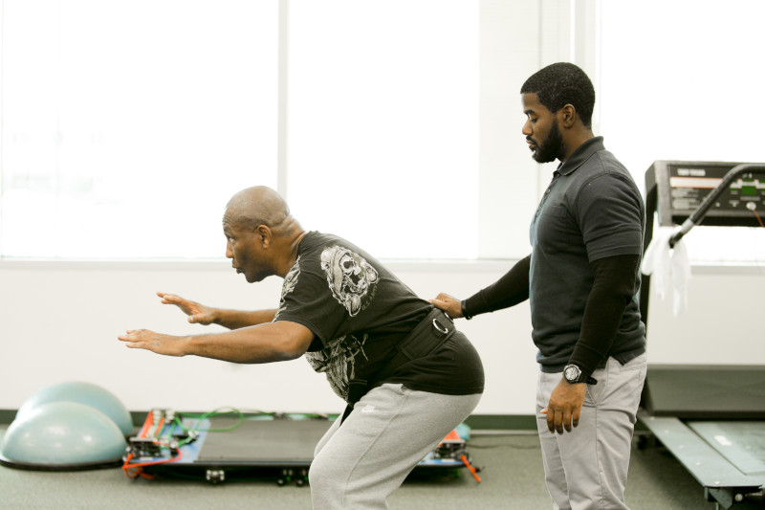
Physical therapy helps you improve body control and movement patterns.
Notes:
Physical therapy can help with things like:
Improving body control and mechanics:
If you are an athlete or have a job where you do a lot of lifting and pulling, you need to know how to properly move your body to prevent injury.
Let’s learn the proper way to pick up a heavy box or something off the floor:
Demonstrate how to properly pick up a pencil off the floor.
Ask the audience to join you.

Slide 7
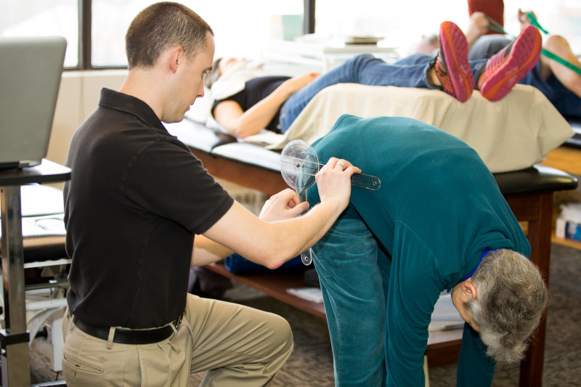
Physical therapy
increases
flexibility and
joint movement.
Notes:
Physical therapy can help with things like:
Increasing flexibility and joint mobility:
Flexibility helps prevent injury.
Let’s check our flexibility:
Everyone stand up and touch your toes.
Now see if you can touch the ground without bending your knees.

Slide 8
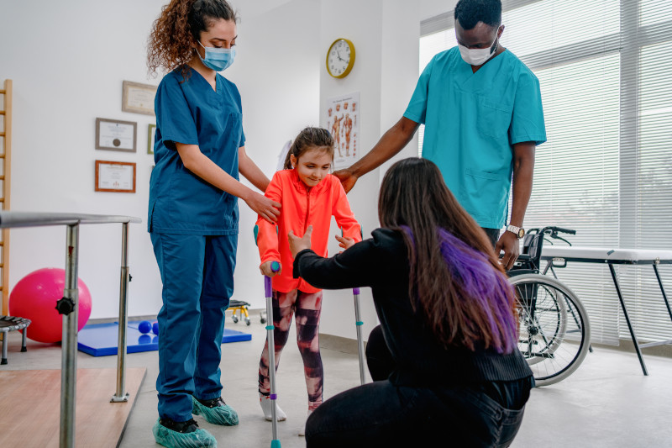
Physical therapy
teaches people
how to move
with assistive devices.
Notes:
Physical therapy can help with things like:
Learning how to move with assistive devices:
If you injure yourself or if you are someone with limited movement you might need an assistive device like a wheelchair, crutches, a walker, or cane to help you move.
PTs teach their patients how to use these devices to increase their ability to move and get around.

Slide 9

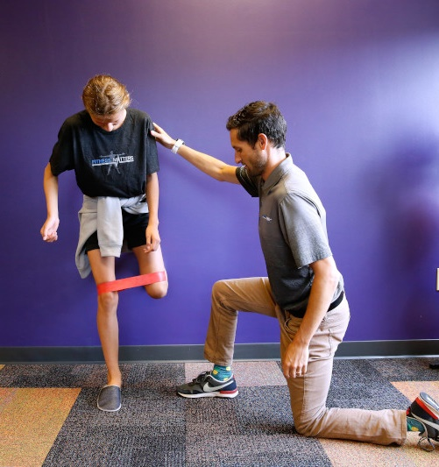
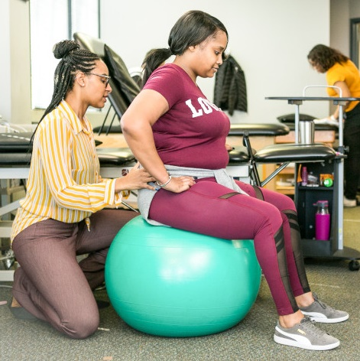
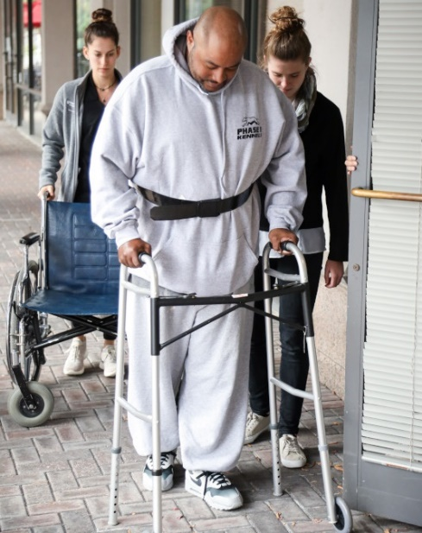
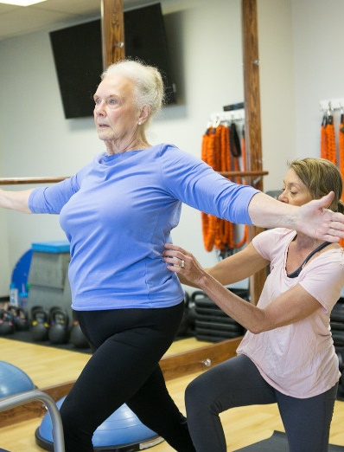
Who Can Benefit From Physical Therapy?
Anyone who moves … which means EVERYONE!
Younger
Older
Notes:
Who can benefit from physical therapy?
Everyone!
If you move, you can benefit from seeing a physical therapist.
Physical therapy helps those who are young, older, and all in between.
PTs help those with conditions and diseases such as:
Chronic pain, such as back, knee, and shoulder pain.
COVID-19.
Heart disease or lung disease.
Cancer.
Balance issues.
Injury recovery
And much more.

Slide 10
Movement Break
Notes:
Lead some movement activities.
Ask your audience to do some sort of quick and easy movement. Be sure to consider those with varying abilities:
10 jumping jacks.
10 hand claps.
Running in place.
Neck or arm circles.
Toe touches.

Slide 11
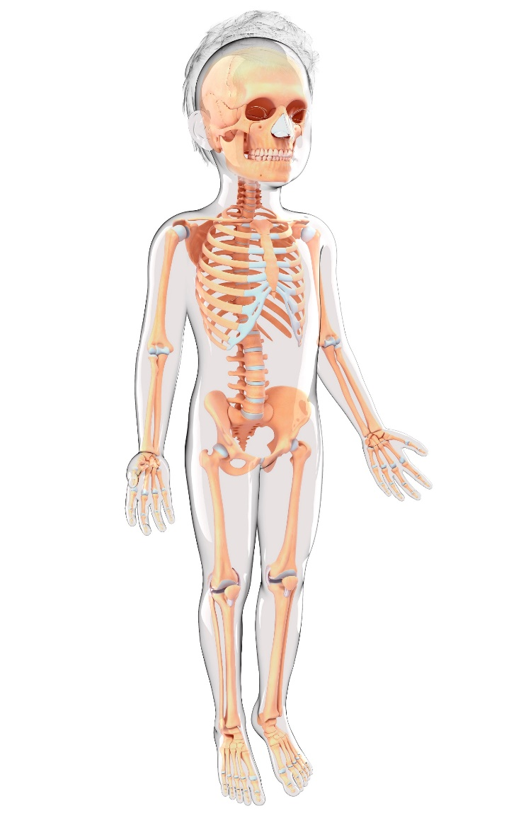
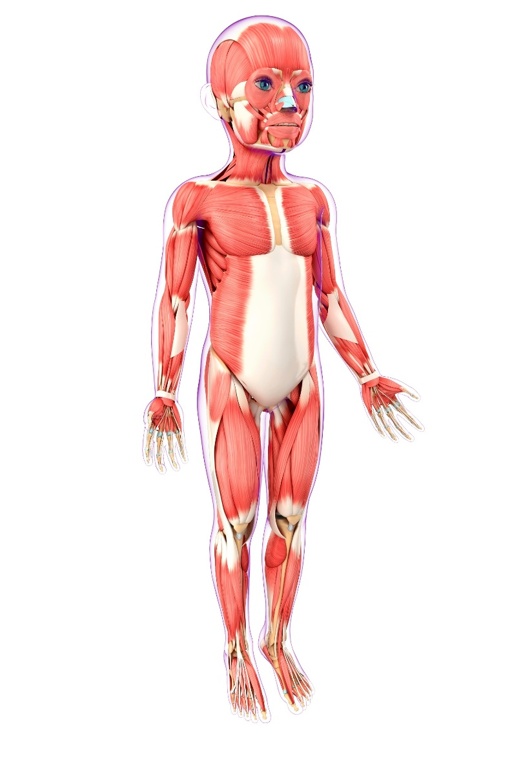
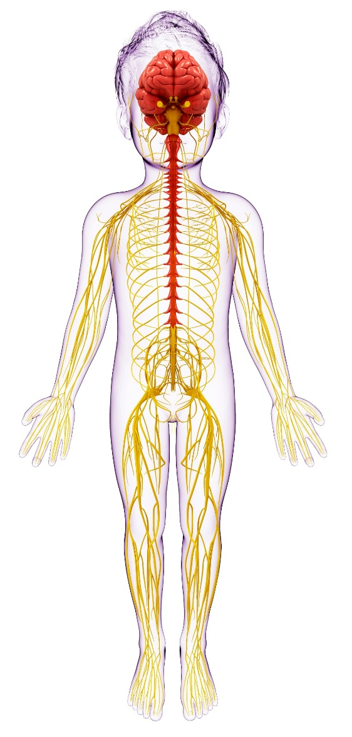
What Body Systems Are Involved in Movement?
Skeletal
Muscular
Nervous
Notes:
Slide 11 and 12 are the same. You can choose which slide will resonate best with your audience.
You just did five jumping jacks (or whatever movement you asked them to do). What parts of your body did you have to move to do ________ (insert movement you asked them to do).
You are looking for answers like (arms, legs, feet, etc.).
Now, what makes your arms and legs move? A combination of your bones, muscles, and nerves all work together to help you move:
Muscles attach to bones, and your brain sends signals to your muscles through your nerves that cause you to move.
Physical therapists are experts in how the body moves, and that is why they are so good at helping when your body doesn’t move like it’s supposed to.

Slide 12
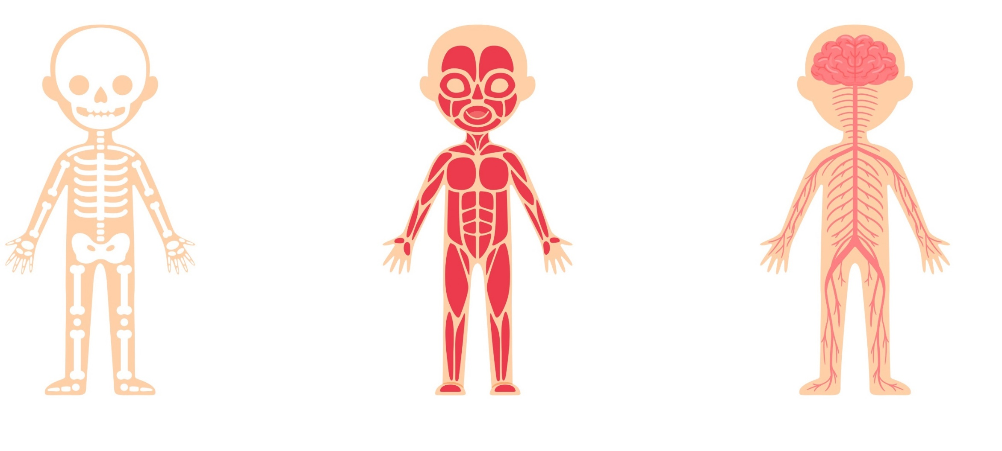
What Body Systems Are Involved in Movement?
Skeletal
Muscular
Nervous
Notes:
Slide 11 and 12 are the same. You can choose which slide will resonate best with your audience.
You just did five jumping jacks (or whatever movement you asked them to do). What parts of your body did you have to move to do ________ (insert movement you asked them to do).
You are looking for answers like arms, legs, feet, etc.
Now, what makes your arms and legs move? A combination of your bones, muscles, and nerves all work together to help you move:
Muscles attach to bones, and your brain sends signals to your muscles through your nerves that cause you to move.
Physical therapists are experts in how the body moves, and that is why they are so good at helping when your body doesn’t move like it’s supposed to.

Slide 13
Physical Therapy Treatment
Notes:
Ask the audience: What are some things you think physical therapists and physical therapist assistants use to help people move better?
Doctors use things like prescription medicine to treat patients.
Dentists use things like teeth-cleaning tools to help patients.
Physical therapists use movement!
Physical therapy is a very active profession. You will spend a lot of time with your patients and really get to know them. And you will move with your patients and sometimes that requires assisted devices, techniques, and creativity.
Here are a few treatment techniques used:

Slide 14
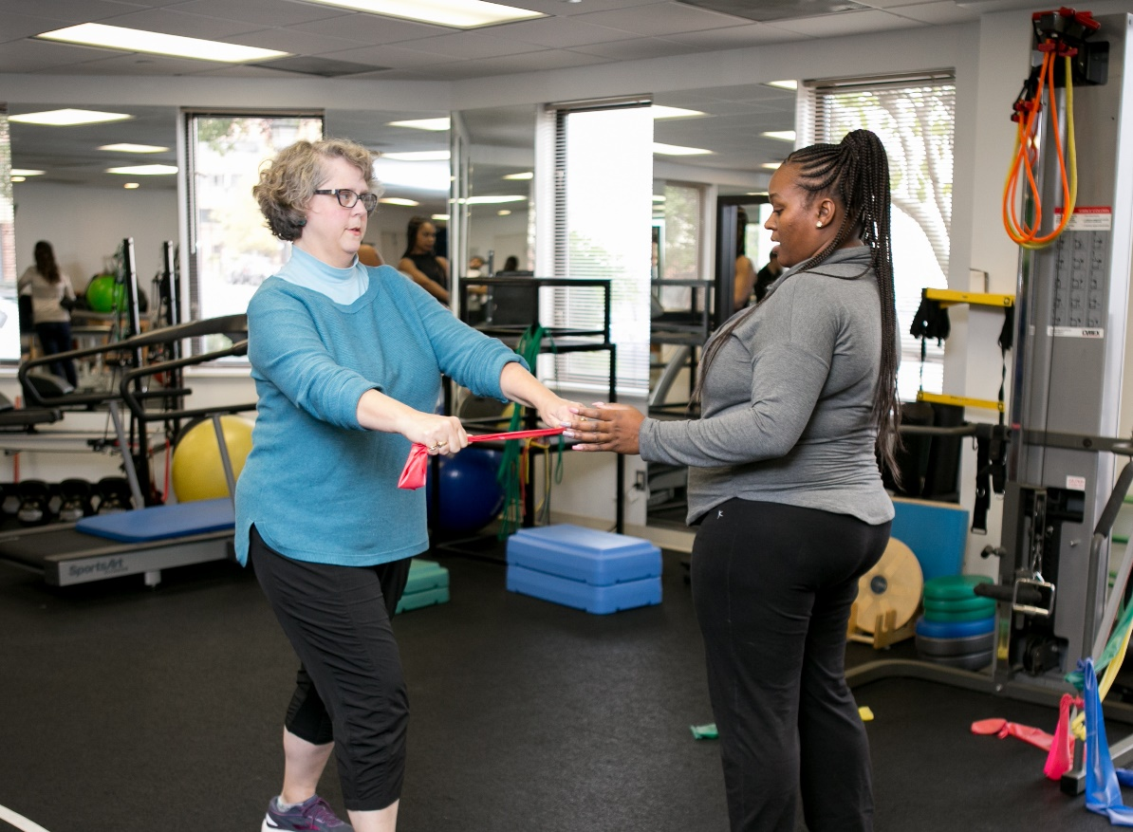
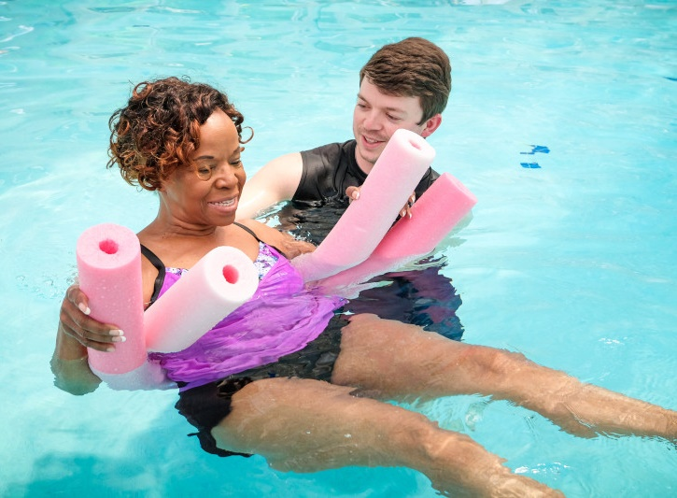
How Do PTs and PTAs Treat Patients?
Exercise Equipment
Pools
Notes:
Physical therapists use movement! Here are some equipment and techniques they use to help you move:
Exercises using equipment and body weight, which teaches proper movement mechanics and strengthening muscles.
Pools or aquatic physical therapy, which helps decrease stress on the joints and muscles while providing resistance that helps with physical therapist treatment.

Slide 15
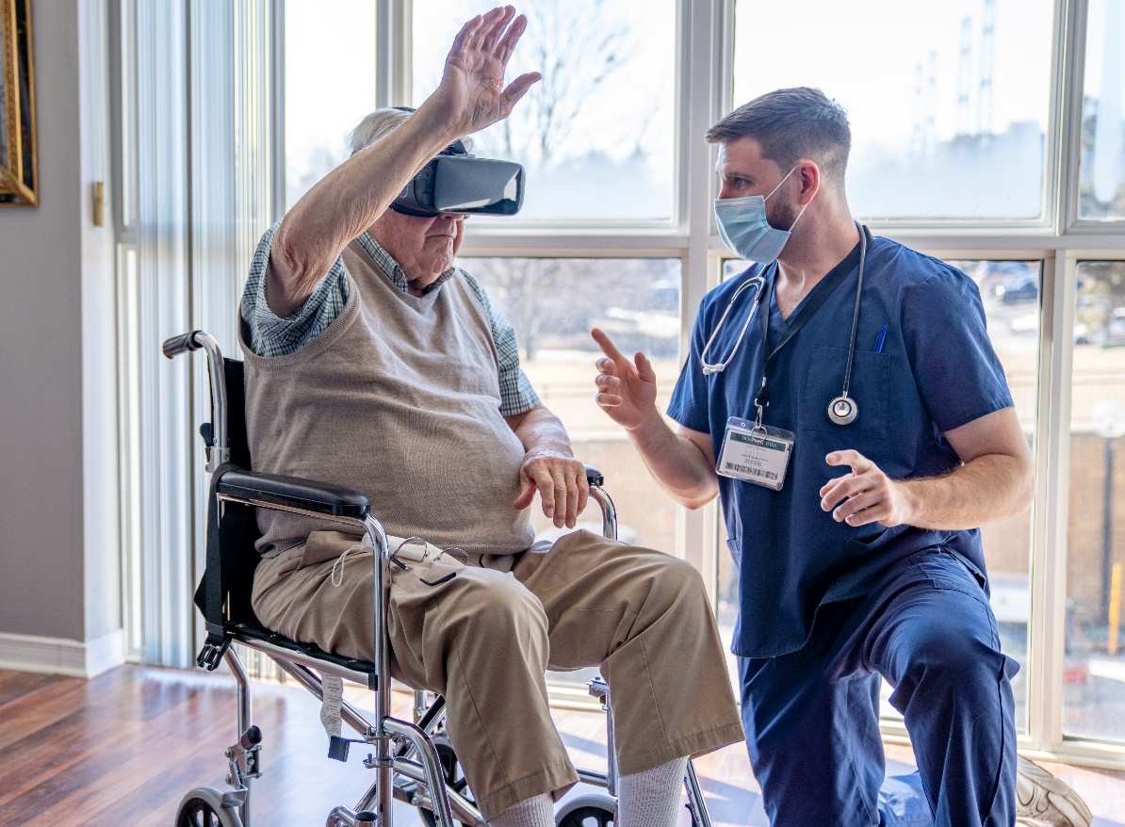

How Do PTs and PTAs Treat Patients?
Robotics and Virtual Reality
Toys and Games
Notes:
Technology and research. Physical therapy is a research heavy profession, and PTs and PTAs are trained to be evidence-based providers who use treatment techniques that are supported by current research and evidence.
Toys and games including video games, virtual reality, and robotic devices. When you are playing video games, playing with toys, and playing games, you are moving! So, they can also be used to teach proper movement mechanics and help patients regain movement.

Slide 16
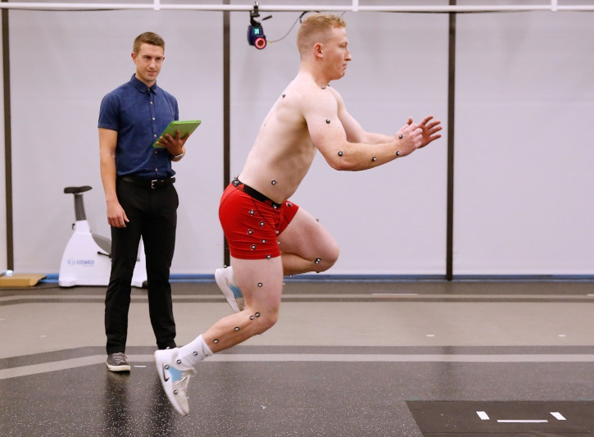
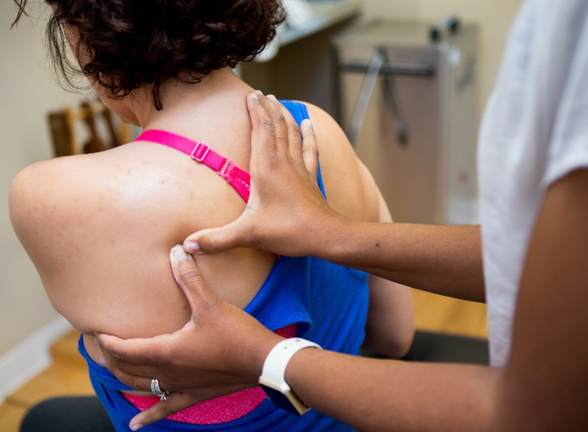
How Do PTs and PTAs treat Patients?
Technology and Research
Massage and Manual Therapy
Notes:
Technology and research. Physical therapy is a research-heavy profession, and PTs and PTAs are trained to be evidence-based providers who use treatment techniques that are supported by current research and evidence.
Manual therapy and electrical stimulation. PTs and PTAs are trained to locate muscles, joints, nerves, bones, and tendons through physical touch. PTs and PTAs can use massage, electrical stimulation, and other manual therapy techniques to treat patients:
Palpation and manual therapy:
Hold out your arm and touch your upper arm (bicep). Now flex your arm and make a muscle. Did you feel your muscle move? Does anyone know the name of this muscle? That’s your bicep muscle.
Extend your arm again but this time feel the back of your arm (triceps). Now flex your arm again. Did you feel your muscle move? Anyone know the name of this muscle? That’s your triceps muscle.
Now touch the back of your lower leg (calf). Flex your foot. Do you feel your muscle move? Anyone know the name of this muscle? That’s your gastrocnemius, also called your calf muscle.
A small prize to give out during this section of the presentation helps with engagement (piece of candy, toy, etc.). Check with the person organizing the presentation first to see if prizes are allowed.

Slide 17
Time to Move!
Notes:
Since PTs and PTAs focus on movement, let’s get up and get moving!
Choose from various activities: With these activities it’s important to:
Explain the importance of each activity, how it’s beneficial (functional movement, etc.).
Use your judgment on what’s appropriate and safe depending on your audience and your environment. Safety first!
Be ready to provide modifications for those with physical limitations.
Examples of exercises and activities:
Stand up from the floor without using your hands.
Stand on one leg with your eyes closed.
Walk heel to toe with your eyes open, then with your eyes closed (partner exercise).
Perform a Y-reach.
Stretch.
Sit back-to-back on the floor and use body weight to stand up (partner exercise).

Slide 18
Remember…
Physical Therapy keeps people moving!
and
Movement is essential to life!
Notes:
After the movement activity is complete bring everyone back together and remind them:
Movement is essential to life, and physical therapy helps to keep people moving.
Just since we have been together today, you have done quite a bit of movement:
Squats = picking up boxes.
Stretching = touching toes.
Jumping jacks or hand claps.
Flexed and extended muscles = biceps, triceps, and gastrocnemius muscles.
Breathing = diaphragm.
So, keep moving, because movement is an important part of life.

Slide 19
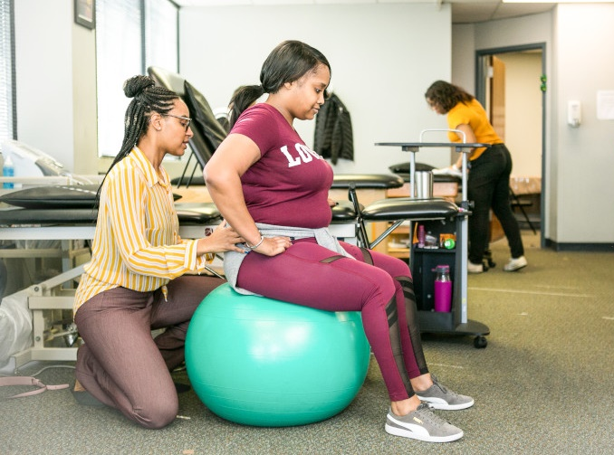
If You Like Being:
Active,
Creative, and
Helpful.
Consider a career as a physical therapist or a physical therapist assistant.
Notes:
Call to a Career in physical therapy!
If you like science, being active, talking to people, and being creative, then physical therapy might be a great career choice for you!

Slide 20
Thank You

Slide 21
Optional Slides to Add If Needed

Slide 22
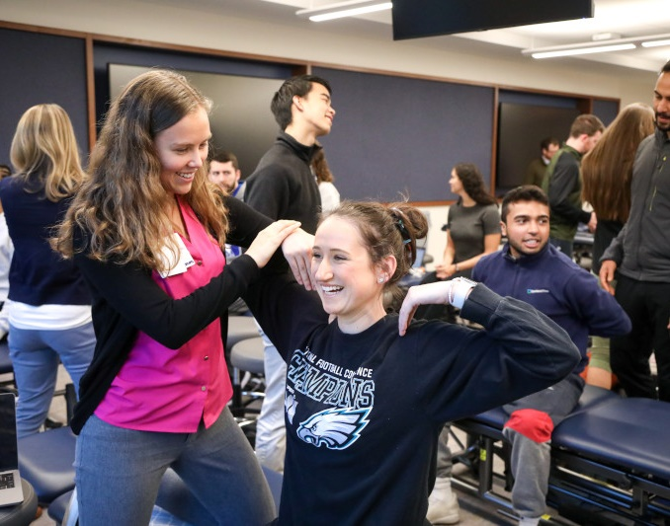
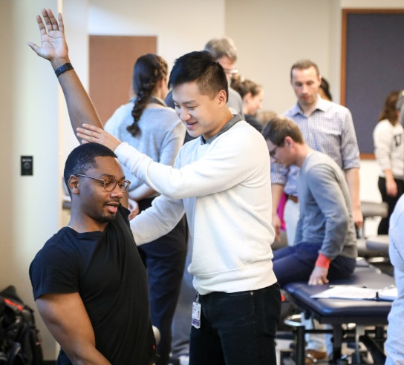

Pathway to DPT
High school diploma or GED
4-year Bachelor’s degree
3-year DPT degree*
PT licensure exam
PT
* Some DPT programs offer freshman entry
Notes:
To be a physical therapist, like most health professions, you will have to attend college and complete an undergraduate/bachelor’s degree, which takes about four years. Then you will need to earn a professional doctor of physical therapy graduate degree, which takes approximately three years.
The average salary for a physical therapist is about $89,000.

Slide 23
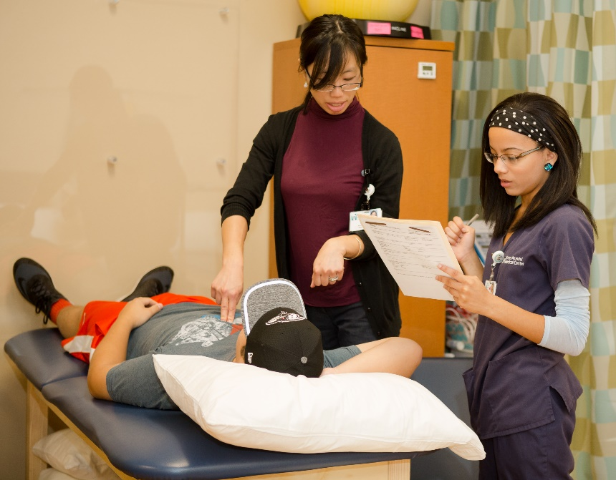


Pathway to PTA
High school diploma or GED
2-year associate degree
PTA licensure exam
PTA
Notes:
To be a physical therapist assistant, you will need to earn a two-year associate degree after high school.
The average salary for a physical therapist assistant is about $58,200.

Slide 24
Questions & Answers

