Slide 1
The Physical Therapy Profession
Month DD, YYYY
Name or Location [Arial 20pt, White]

Slide 2


Slide 3
Introduction to Physical Therapy
Notes:
Today you’ll learn more about the profession of physical therapy and why it is a great career option for you to consider. Let’s start with the basics.

Slide 4
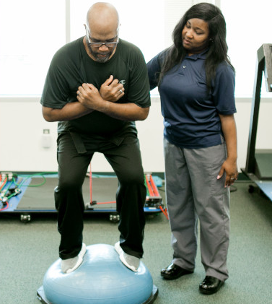
Physical therapy is treatment provided by a physical therapist or physical therapist assistant that helps people improve their movement and physical function, manage pain and other chronic conditions, and recover from and prevent injury and chronic disease.
Notes:
What is physical therapy? Here is a formal definition, but, in short, physical therapy helps people move better. It helps improve movement and physical function to prevent and/or treat injury and chronic disease.
Big picture: Physical therapy is vital because it keeps people moving, and movement is one of the keys to life. Think about how your life would change if you couldn’t move or your mobility was limited in a way you are not used to.
Movement doesn’t refer just to running and dancing; we’re also talking about sitting and standing, walking, playing, bathing, breathing, even keeping lymph moving through your body. Physical therapists help keep people moving so they can live life to the fullest.

Slide 5
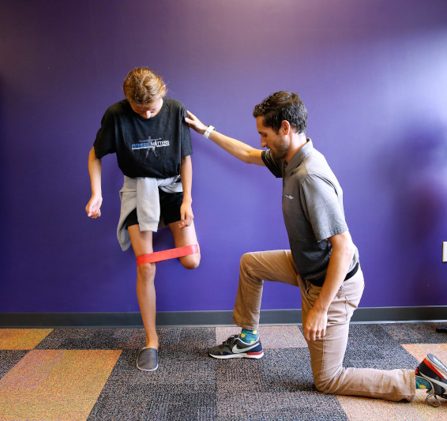
Physical Therapists Are Movement Experts
Licensed doctors who examine, diagnose, and treat movement dysfunction.
Help people impacted by disease, injury, and disability.
Prevent movement loss and promote wellness.
Use therapeutic exercise, modalities, assistive devices, patient education, and evidence-based research to treat patients.
Notes:
Physical therapists are licensed health care providers who help people move better. They are educated with a professional doctoral degree and trained to examine, diagnose, and treat movement dysfunction, as well as to optimize movement function.
They are anatomy and physiology experts. Physical therapists have an in-depth knowledge of the body’s muscles, bones, nerves, ligaments, tendons, blood vessels, fascia, etc., and how they all work together to keep people moving.
Physical therapists use movement, exercise, modalities, and techniques such as heat, cold, electrical stimulation, manual therapy, and light therapy to treat movement dysfunction and prevent injury.

Slide 6

Physical Therapist Assistants Collaborate With PTs
Educated and licensed or certified clinicians.
Provide physical therapy services under the direction and supervision of a licensed physical therapist.
Implement components of patient care, obtain data related to the treatments provided, and collaborate with physical therapists to modify care, as necessary.
Physical therapist assistants are not the same as physical therapy aides.
Notes:
Physical therapist assistants are licensed or certified clinicians that provide physical therapist services under the direction and supervision of a licensed physical therapist.
Physical therapist assistants are not trained to examine and diagnose as physical therapist are, but they are trained to assist with the implementation of patient care and treatment.
There is a difference between physical therapist assistants and physical therapy aides. PTAs are licensed or certified clinicians trained to provide health care services, while physical therapy aides perform nonmedical tasks and assist with clinic duties, working under the supervision of PTs and PTAs.

Slide 7
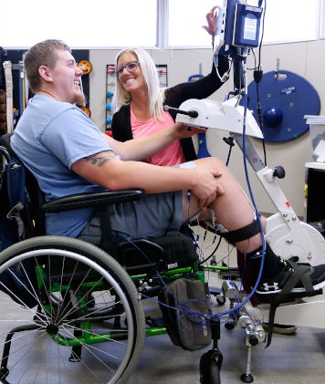
More than 21 million U.S. adults have a disability.
Physical therapists can develop a physical activity plan for people with physical disabilities based on their individual goals, needs, and challenges.
Notes:
One of the many patient populations that physical therapists and physical therapist assistants treat are those living with a disability. In the United States, 21 million adults have some sort of disability, including the loss of mobility.
(Source: CDC Vital Signs, May 2014)
Physical therapists examine, develop a treatment plan, and work with patients to help regain, maintain, prevent, or slow the loss of movement.

Slide 8
8 Things You Didn’t Know About Physical Therapy
Notes:
There are a lot of misconceptions about what physical therapy is. The next few slides will give you a better understanding of what physical therapy is, what PTs and PTAs do, and what you can do as a physical therapist.

Slide 9
1. Only Licensed PTs and PTAs Can Provide Physical Therapist Services
Physical Therapists are not:
Physical Therapists are:
Personal trainers.
Massage therapists.
Athletic trainers.
Chiropractors.
Movement and body mechanics experts.
Licensed clinical doctors.
Evidence-based practitioners.
Trained to diagnose, examine, and treat all populations.
Notes:
Only PTs and PTAs can provide physical therapist services. Other health professions deal with movement as well, but only physical therapists can provide physical therapy. It’s true that massage/manual therapy is one of the many techniques PTs use for treatment, but it is by far not the only technique. Physical therapists most definitely treat athletes, but it they treat a wide variety of other populations as well. Physical therapists use exercise and movement to treat patients. The goal is to increase movement ability and help heal the body using that movement.

Slide 10

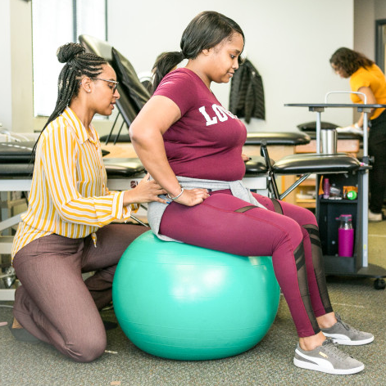
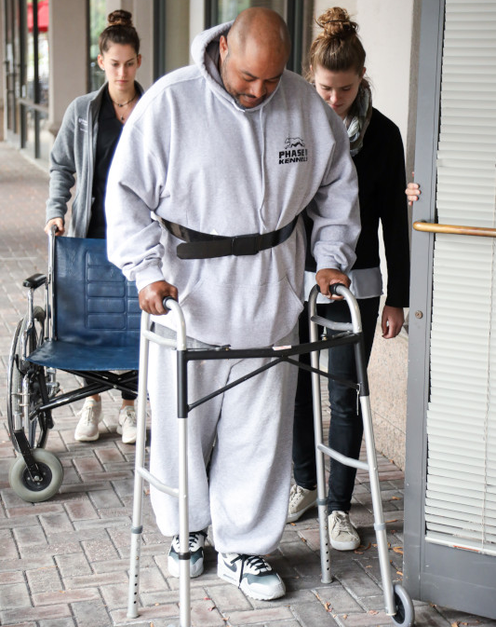
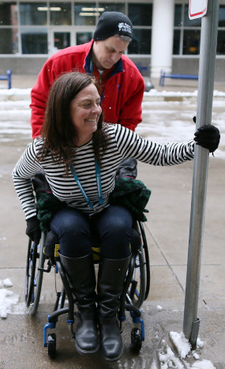
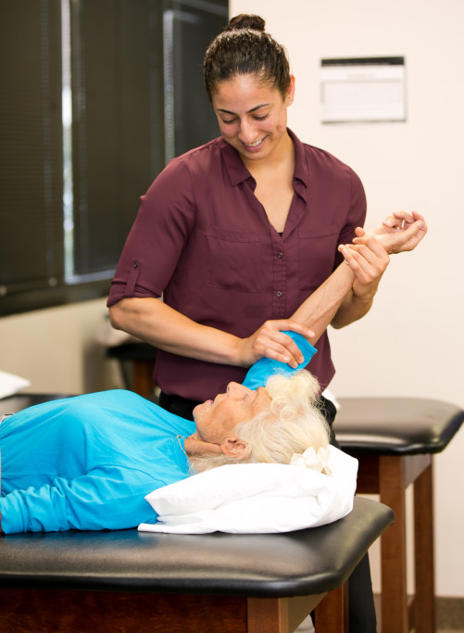
2. PTs and PTAs Care for People of All Ages and Abilities
They treat patients across the lifespan (birth to end of life)
Notes:
Physical therapists and physical therapist assistants treat patients across the lifespan, from infancy to end of life. As a PT you can work with pediatric through geriatric patient populations and all in between.

Slide 11
3. PTs and PTAs Work Throughout the Health Care System
Hospitals and Acute Care Facilities
Outpatient Clinics
Nursing Homes
Assisted-Living Facilities
Home Health
Schools
Sports and Fitness Facilities
Corporate Offices
Military
Public Health
More…
Private Practice
Notes:
Physical therapists and physical therapist assistants can be found throughout the health care system. Inpatient and outpatient clinics, acute care facilities, corporate offices, wellness facilities, schools, etc.

Slide 12
4. PTs and PTAs Can Focus on Specific Areas of Care
PT Specialties
PTA Proficiencies
Cardiovascular & Pulmonary
Clinical Electrophysiology
Geriatrics
Neurology
Oncology
Orthopaedics
Pediatrics
Sports
Women’s Health
Wound Management
Acute Care
Cardiovascular & Pulmonary
Geriatrics
Oncology
Orthopaedics
Pediatrics
Wound Management
Notes:
Physical therapists and physical therapist assistants are trained to treat all patient populations and work in multiple environments and specialties. Many people are not aware that there also are specialty areas within the profession of physical therapy. You can choose to be a generalist or focus on a specialty area.

Slide 13
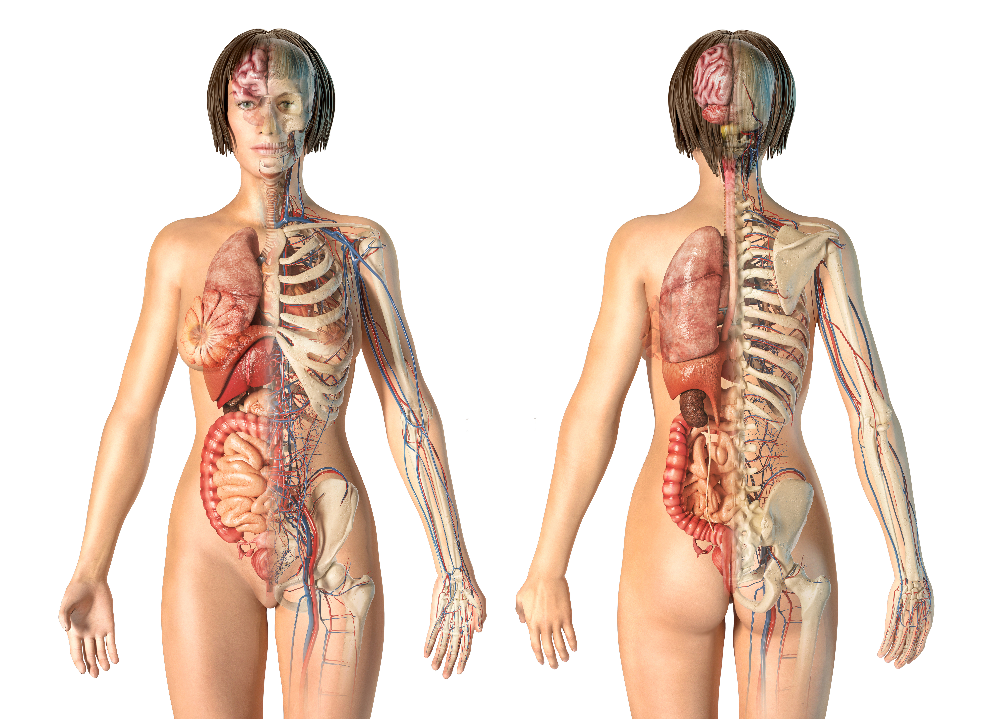
5. PTs and PTAs Treat Multiple Body Systems
They also manage and decrease symptoms associated with diseases and disorders.
For example:
Cardiovascular: Coronary artery disease
Respiratory: Chronic obstructive pulmonary disease
Integumentary: Skin burns
Muscular/Skeletal: Back pain, dislocations/fractures
Nervous: Stroke, traumatic brain injury, vertigo
Urinary/Renal: Incontinence
Reproductive: Pelvic pain
Immune/Lymphatic: Lymphedema
Digestive: SIBO, GERD, IBS
Notes:
Our body moves in so many different ways, and movement has an impact on more than just our muscles and bones. Physical therapists and physical therapist assistants treat musculoskeletal concerns; however, they also treat and manage diseases, injuries, and disorders involving multiple other body systems, including the cardiovascular, respiratory, integumentary, nervous, and reproductive systems.
This means that physical therapists manage more than just athletes or orthopedic patients. They work with patients who have cardiac disease, have had a stroke or brain injury, who have been severely burned, and who are postpartum, to name a few populations.

Slide 14
6. You Do Not Have To Be a Science Major* To Pursue a Career in Physical Therapy
Popular Majors
Exercise/health science
Spanish
Business administration
Psychology
Liberal arts
*You will have to take science courses, but you do not have to be a science major.
Notes:
To be a physical therapist or physical therapist assistant you can have interests outside of science. Here are a few of the popular nonscience undergraduate majors of students entering doctor of physical therapy programs.
If you want to be a physical therapist assistant, you can enter a program straight from high school.
Keep in mind that you will have to take science courses while enrolled in a PT or PTA program, as it is a profession that is heavy on anatomy, physiology, biomechanics, and basic sciences.
So, if you’re interested in foreign language, theatre, history, or dance, you can still be a physical therapist or PTA. Just be sure to do well in your science courses.

Slide 15
7. There Are Two Physical Therapy Career Pathways
Pathway to DPT
High school diploma or GED
Bachelor’s degree
Three-year DPT degree*
DPT licensure exam
* Some DPT programs offer freshman entry
Pathway to PTA
High school diploma or GED
Two-year associate degree
PTA licensure exam
Notes:
There are two pathways you can choose to enter the profession of physical therapy.
You can be a physical therapist or physical therapist assistant. Both career pathways involve working with patients. However, as mentioned before, physical therapists are trained to examine, diagnose, and treat patients, while physical therapist assistants are trained to assist physical therapists with patient treatment. Physical therapists must obtain a bachelor’s degree and then a three-year clinical doctor of physical therapy degree. Physical therapist assistants must obtain a two-year associate degree.

Slide 16
8. As a Physical Therapist You Can Be a ….
Clinical practitioner.
Board-certified specialist.
PT resident.
PT fellow.
Professor/program director.
Researcher.
Professional advocate.
APTA staff/CEO/Board member.
Travel PT.
Entrepreneur.
Influencer.
More …
Notes:
As a physical therapist you will be a trained clinician; however, there are multiple pathways you can choose within this profession. You can be a general practitioner, a specialist, researcher, professor/clinical educator, advocate, entrepreneur, CEO, board member, and more. Or a combination of these things.
So, in addition to treating patients, there are other professional opportunities available to you as a physical therapist.

Slide 17
Physical Therapy Education
Notes:
Let’s look into a quick overview of what it takes to become a physical therapist or physical therapist assistant.

Slide 18
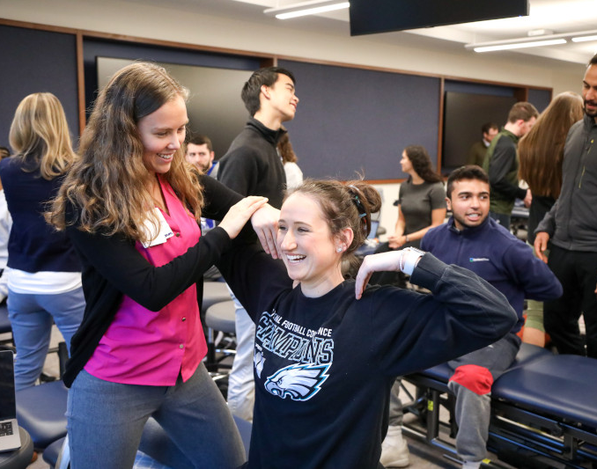
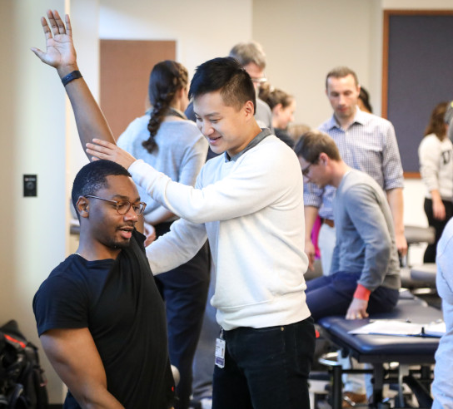

Pathway to DPT
High school diploma or GED
Bachelor’s degree
3-year DPT degree*
DPT licensure exam
* Some DPT programs offer freshman entry
Notes:
To be a physical therapist you must complete a professional doctor of physical therapy degree from a CAPTE-accredited physical therapist program. Upon completion of the DPT program, you’ll take the National Physical Therapy Examination for PTs.

Slide 19
DPT Application and Education
Time Commitment
Bachelor’s degree
(~4 years)
3-year DPT program
Preparation
Strong science background
Understanding of the profession (www.apta.org)
Applying
PTCAS
Application opens in July
Curriculum
Degree
Clinical
Didactic/lab
NPTE licensure exam
Doctor of physical therapy degree
Notes:
Time Commitment:
To enter a DPT program you must obtain a bachelor’s degree, then most DPT programs take three years to complete. However, there are some freshman-entry programs.
Preparation:
The DPT program curriculum is heavy on basic science, so having a strong science foundation is helpful (biology, chemistry, physics, anatomy, physiology, biomechanics, etc.). You also want to make sure you have a good understanding of the profession and what physical therapists do. You can do this can by shadowing a PT, volunteering, finding a PT or PT student mentor, and looking at the APTA website (www.apta.org), among other things.
Applying:
Most DPT programs require prerequisite courses, PT observation hours, and letters of recommendation as part of their application process. Also, 95% of DPT programs require applicants to apply via the Physical Therapy Centralized Application Service. You can visit www.PTCAS.org for more detailed application information, requirements, average GPAs, and more.
Curriculum:
Most DPT programs have a combination of didactic/classroom, lab, and clinical coursework. In additional to classroom learning you will have intensive anatomy and physiology courses and labs and be required to complete clinical rotations.
Degree:
Upon completion of a DPT program you will obtain a doctor of physical therapy degree, and when you pass the National Physical Therapy Examination you will become a licensed physical therapist.

Slide 20
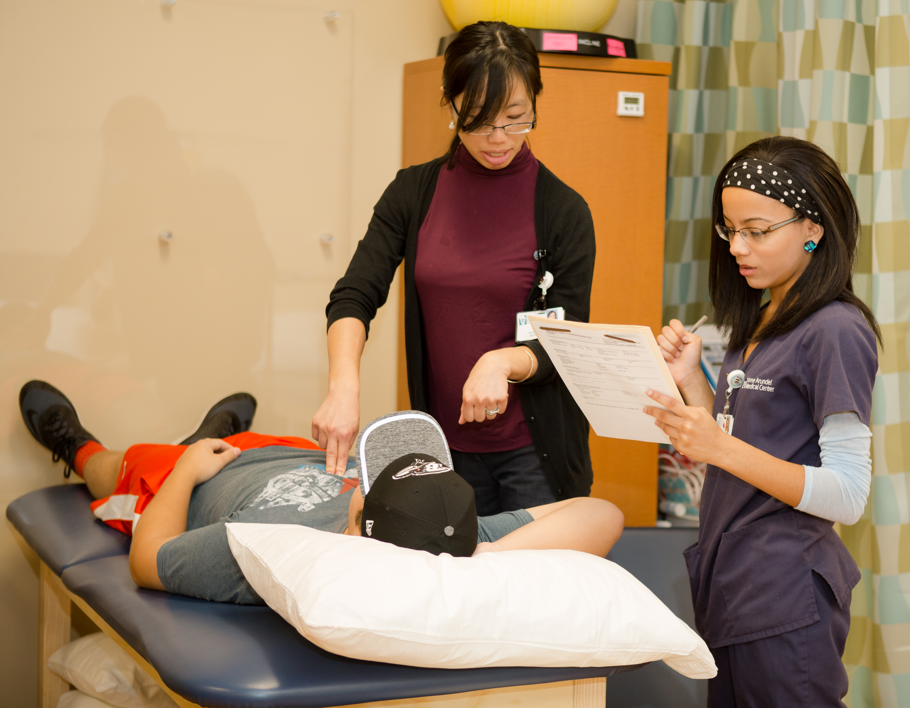


Pathway to PTA
High school diploma or GED
Two-year associate degree
PTA licensure exam
Notes:
To be a physical therapist assistant you must complete a two-year associate’s degree from a CAPTE-accredited physical therapist assistant program. Upon completion of the program, you’ll take the National Physical Therapy Examination for PTAs.

Slide 21
PTA Application and Education
Time Commitment
High school
Two-year PTA program
Preparation
Science background
Understanding of profession
Applying
PTACAS
Individual program applications
Curriculum
Degree
Clinical
Didactic/lab
Licensure exam / certification
Associate degree
Notes:
Time Commitment:
To enter a PTA program you must obtain a high school diploma or GED. Most PTA programs take two years to complete. However, some programs will accept transfer credits, so it could take less than two years.
Preparation:
To prepare for PTA program application, you also want to have a good understanding of anatomy and physiology. You also want to make sure you have a good understanding of the profession and what physical therapist assistants do. You can do this by shadowing a PT or PTA, volunteering, finding a PTA or PTA student mentor, and by looking at the APTA website (www.apta.org), among other things.
Applying:
Some PTA programs require prerequisite courses, physical therapy observation hours,and letters of recommendation as part of their application process.
APTA recently launched the Physical Therapist Assistant Centralized Application Service. Participating PTACAS programs will have a link to the application service on their website. You can also visit individual PTA program websites for program application instructions. CAPTE provides a list of all PTA programs around the country.
Curriculum:
PTA programs have a combination of didactic/classroom, lab, and clinical coursework.
Degree:
Upon completion of a PTA program, you will obtain an associate degree, and when you pass the National Physical Therapy Examination you will become a licensed physical therapist assistant.

Slide 22
Why Choose Physical Therapy?
Notes:
There are multiple career options, even within health care, but why should you choose the profession of physical therapy?

Slide 23

Movement Is Essential to Life
PTs and PTAs optimize quality of life by focusing on movement loss prevention and optimal movement performance.
Notes:
If you love anatomy, physiology, muscle movement, and exercise, and you’re curious about human body movement in general, then physical therapy is a great career option. Physical therapists and physical therapist assistants do more than help keep people moving — in some instances they help people regain their life.

Slide 24

Boston Marathon bombing survivor Adrianne Haslet thought her quality of life would be a zero. Her physical therapist and the rest of her health care team helped Adrianne to move and to believe again.

Slide 25
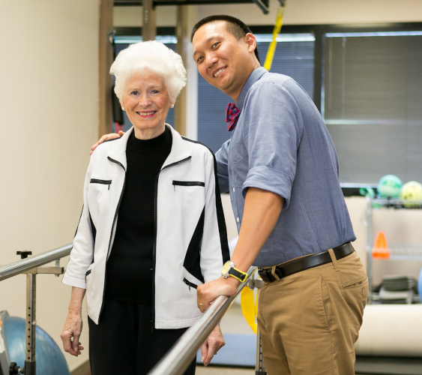
Physical Therapy Is a Personally, Professionally, and Financially Rewarding Career!
Top-ranked health care profession
Growing profession
Median salaries: $89,499 (PT) and $58,520 (PTA)
Fosters relationships with patients
Allows you to see the direct impact and benefit of your work
Notes:
In addition to helping people regain their quality of life:
1. Physical therapy is consistently ranked as one of the top health professions.
Top Ranked Profession (https://money.usnews.com/careers/best-jobs/physical-therapist)
#10 in Best Healthcare Jobs
#15 in 100 Best Jobs
2. It’s a profession that is predicted to continue to grow. People are living longer and want to keep moving on their own as much as possible. Physical therapists are needed.
Cited by U.S. Bureau of Labor Statistics under Job Outlook (https://www.bls.gov/ooh/healthcare/physical-therapists.htm#:~:text=Employment%20of%20physical%20therapists%20is,the%20average%20for%20all%20occupations.&text=In%20addition%2C%20physical%20therapists%20will,such%20as%20diabetes%20or%20obesity)
3. Salary levels are strong. Median PT salary is $89,440 (https://www.bls.gov/oes/current/oes291123.htm). Median PTA salary is $58,520 (https://www.bls.gov/oes/current/oes312021.htm)
4. Physical therapy fosters relationships with patients. Physical therapists on average spend more time with their patients than other health professions do, with 30- to 60-minute appointment times and potential multiple visits that could continues for weeks, months, and maybe even years, depending on the patient’s needs and goals.
5. It is likely that you’ll be able to witness your patient’s progress over time, allowing you to see the physical impact of your work.

Slide 26
How To Prepare
Notes:
What can you do now to start preparing for a future in physical therapy?

Slide 27
Do your research
Observe a PT or PTA
Start
Preparing
Now!
Diversify your experience
Find a mentor
Review anatomy and physiology
Build a strong science foundation
Notes:
1. Do your research: Visit www.apta.org, www.ptcas.org, and individual programs.
2. Shadow or observe a PT or PTA to see what it’s like up close.
3. Diversify your experience: If possible, observe more than one or two days, in a variety of settings, and with a variety of patient populations. An experience in an outpatient orthopedic clinic will be different from an inpatient burn unit or a cardio/pulmonary clinic.
4. Find a mentor: Reach out to a local PT, PTA, or student PT or PTA who is willing to share their experience and guide you through the process.
5. Review anatomy and physiology: PTs are movement experts, and movement is based on understanding how muscles, bones, nerves, blood vessels, and other parts of the body work together to create movement.
6. Build a strong science foundation: Science courses such as biology, chemistry, and physics are required to enter physical therapy school. Anything you can do to ensure a solid foundation in these courses will be helpful.

Slide 28
Resources

Slide 29
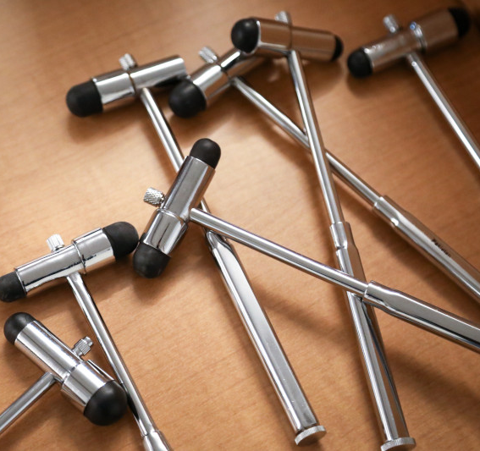
APTA Helpful Resources
American Physical Therapy Association
apta.org
Physical Therapist Centralized Application Service
ptcas.org
Physical Therapist Assistant Centralized Application Service
ptacas.liaisoncas.com
Commission on Accreditation in Physical Therapy Education
capteonline.org
APTA Financial Solutions Center
enrich.apta.org
Questions about PT Careers or Pathway to PT/PTA
studentrecruitment@apta.org

Slide 30




Stay Connected
@APTAPics
@APTATweets
@ChoosePTVideos
@AmericanPhysicalTherapyAssociation

Slide 31
Questions & Answers

Slide 33
Thank You

