Slide 1
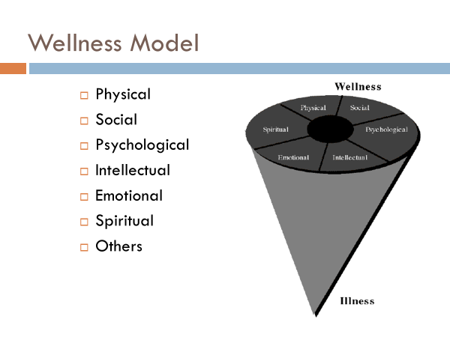
Adams, T., Bezner, J., & Steinhardt, M. The conceptualization and measurement of perceived wellness: integrating balance across and within dimensions. American Journal of Health Promotion. 1997;11(3):208-218. https://journals.sagepub.com/doi/pdf/10.4278/0890-1171-11.3.208
Bezner JR, Promoting Health and Wellness: Implications for Physical Therapist Practice, Physical Therapy. 2015;95(10):1433–1444. https://doi.org/10.2522/ptj.20140271

