Slide 1
Physical Therapy Moves Me!
Kindergarten-2nd Grade Presentation
Notes:
Things to Think About:
When speaking with this age group, the goal is to help them think about what movement is and understand that physical therapy helps people move.
When possible, it helps to get them moving; almost as if they are part of the presentation. If you are using the K-2 Power Point along with these talking points, you will see there is a lot of opportunity to get your audience moving. Think of it as trying to get them to learn while having fun – engaged learning.

Slide 2

Notes:
Welcome.
Introduce yourself and give the reason for your presentation.
Explain what you hope to achieve by the end of the presentation, such as “By the end of this presentation I want you have a better understanding of how PTs and PTAs help people move.”

Slide 3
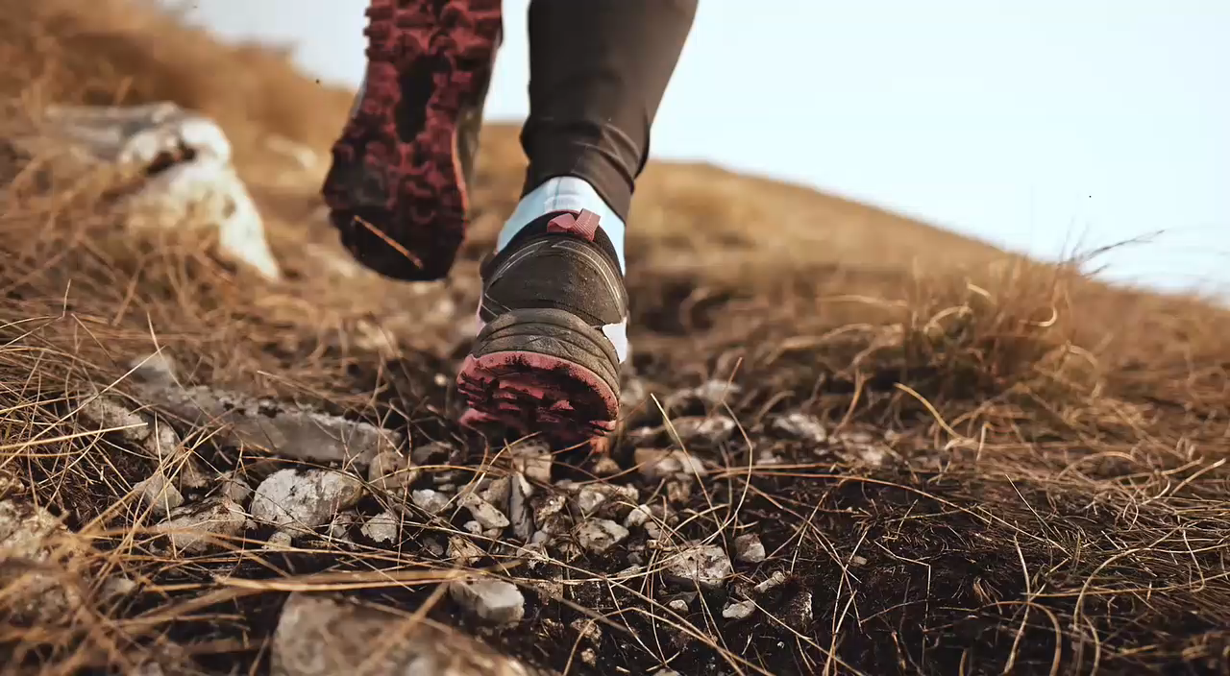
Running
Notes:
Ask the audience “What is this person doing,” and hopefully they will say “running.”

Slide 4
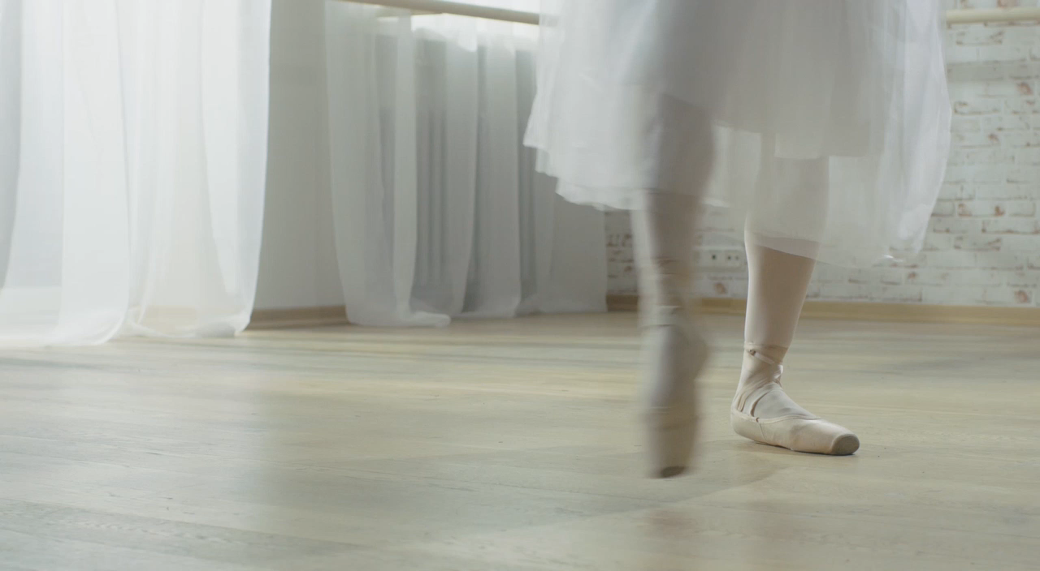
Questions & Answers
Dancing
Notes:
Ask the audience “What is this person doing,” and hopefully they’ll say “dancing.”

Slide 5
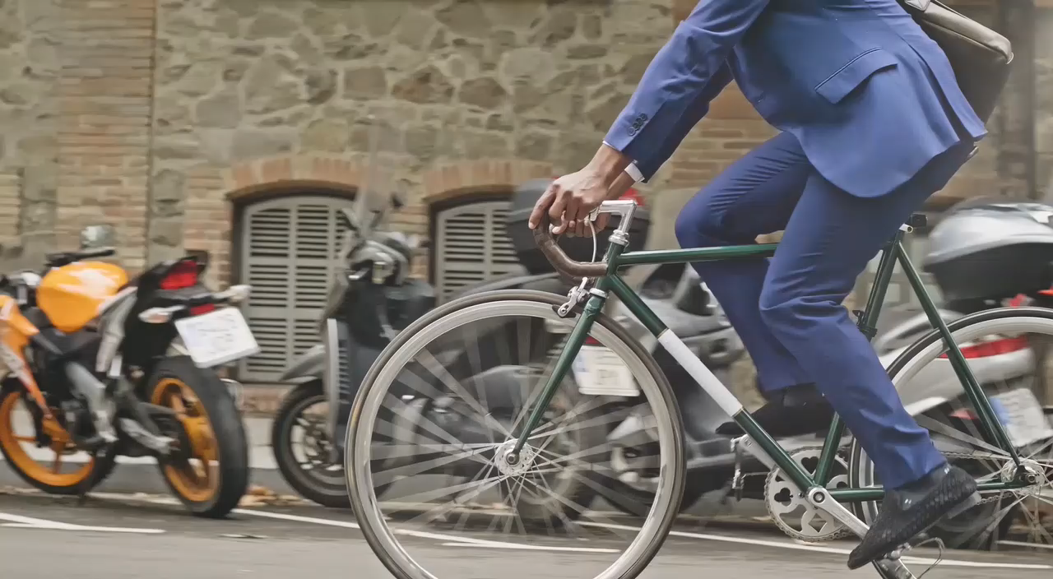
Biking
Notes:
Ask the audience “What is this person doing,” and hopefully they’ll say “riding a bike.”

Slide 6
Movement

Slide 7
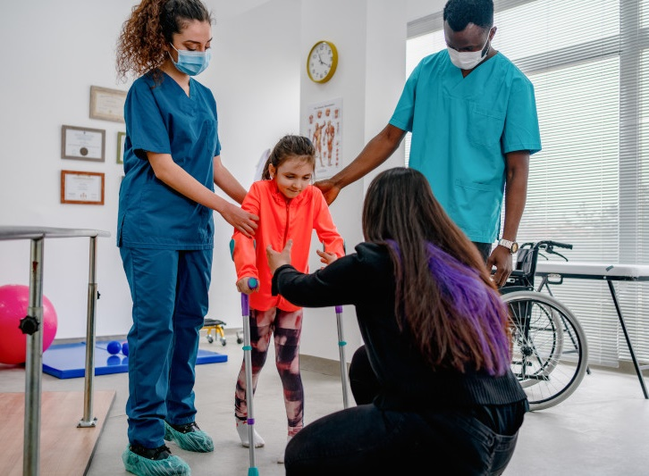
Physical therapy helps people move!
Notes:
Physical therapy helps people perform daily movements such as bending and squatting.
Say “Let me see you bend and touch your toes.”
Say “Let me see you squat.”

Slide 8
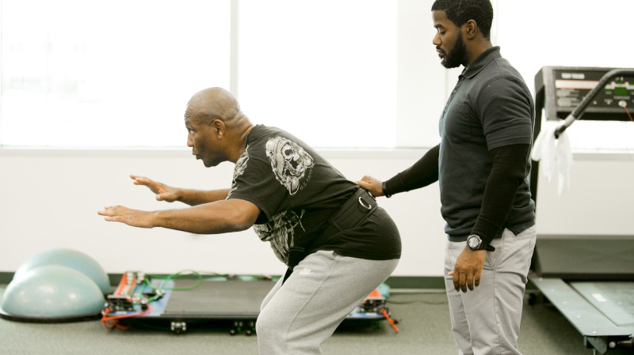
Squat and Bend
Notes:
Physical therapy helps with Daily Movements
They help people do daily movements like bending and squatting
Let me see you bend and touch your toes
Let me see you squat

Slide 9
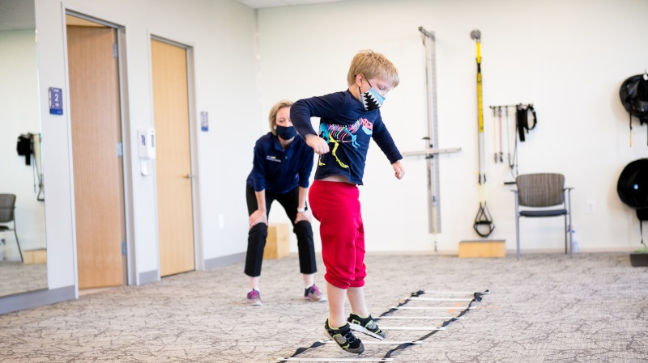
Jump
Notes:
Physical therapy helps people do big movements such as jumping.
Say “Let me see you jump.”

Slide 10
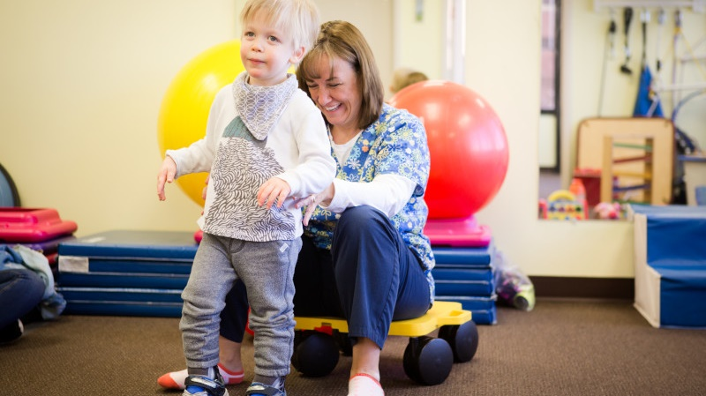
Walk
Notes:
Physical therapy helps people walk.
Physical therapy helps people learn to walk again.
Say “Let me see you walk in place.”

Slide 11
Game Time!
Notes:
Now it is time to get moving.
Choose from the list of age-appropriate activities:
Simon Says.
Relay Races (bunny hops, sideways bunny hops, skips, walking, side steps, slow jog).
Stretching exercises.
Basic balance activity.

Slide 12
Physical Therapist Treatment
Notes:
Doctors use things such as prescription medicine to treat patients.
Dentists use things such as teeth-cleaning tools to help patients.
Physical therapists use movement to help treat patients, along with other things!
Here are a few treatment techniques used:

Slide 13
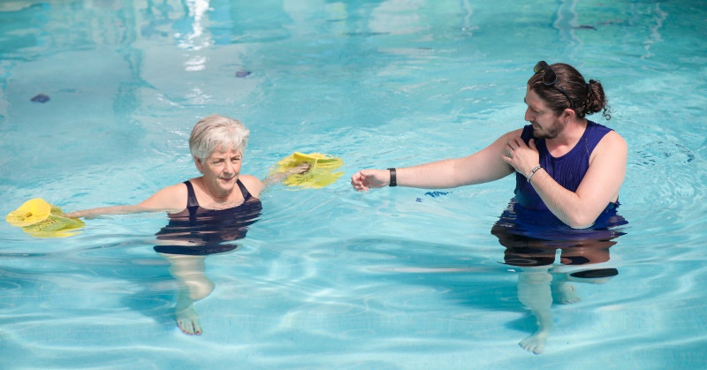
Pools
Notes:
Pools or aquatic physical therapy – water helps decrease stress on the joints and muscles while providing resistance that helps with physical therapist treatment.

Slide 14
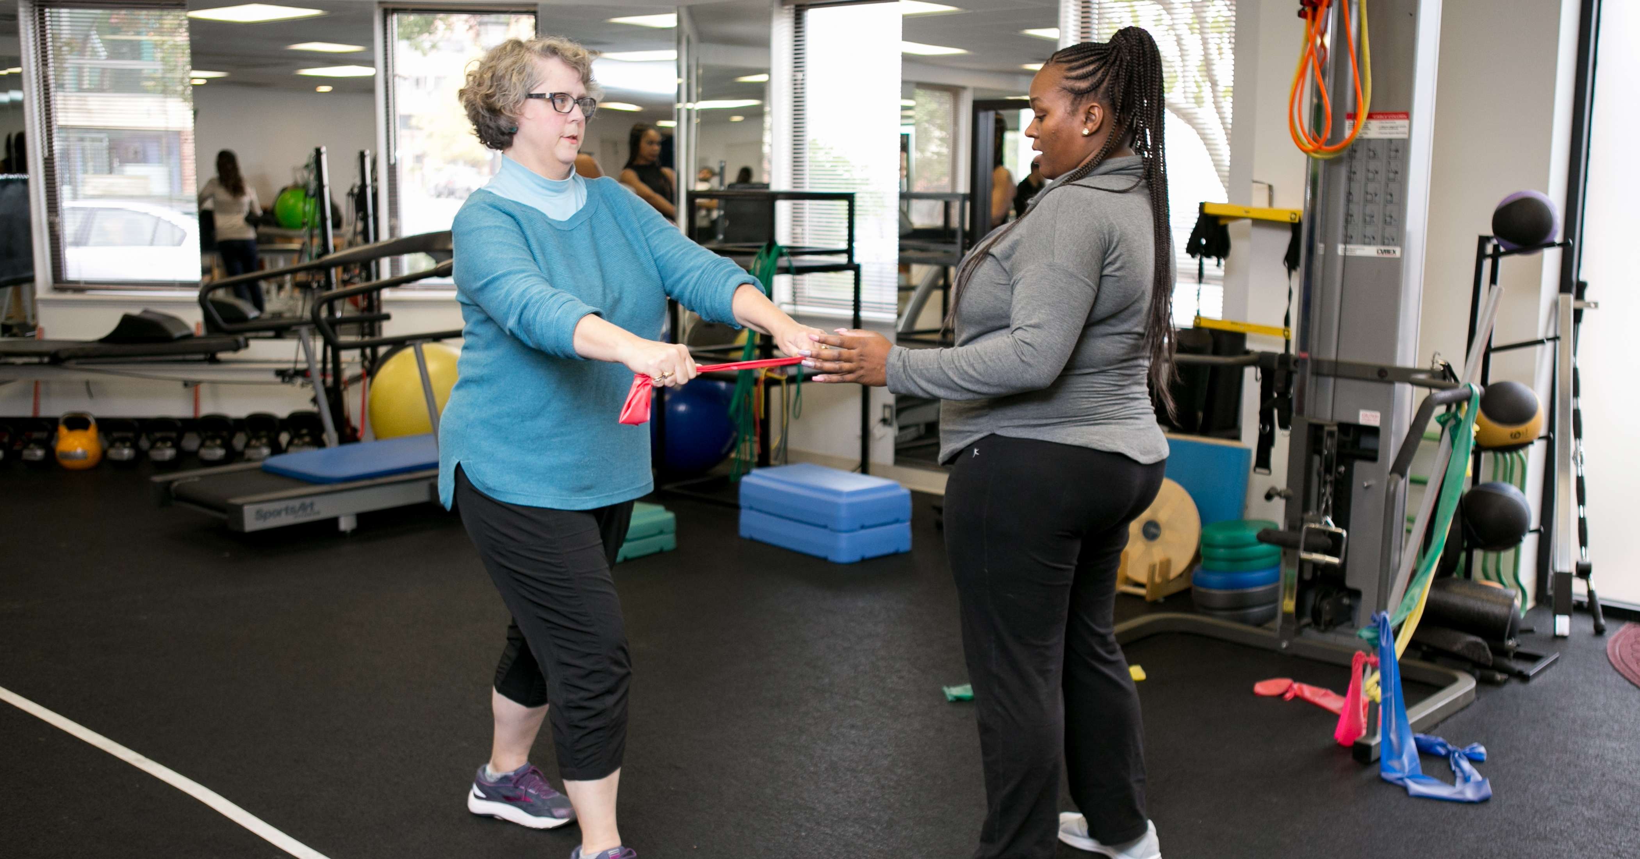
Exercise Equipment
Notes:
Exercises using equipment and body weight – teaching proper movement mechanics and strengthening muscles.

Slide 15
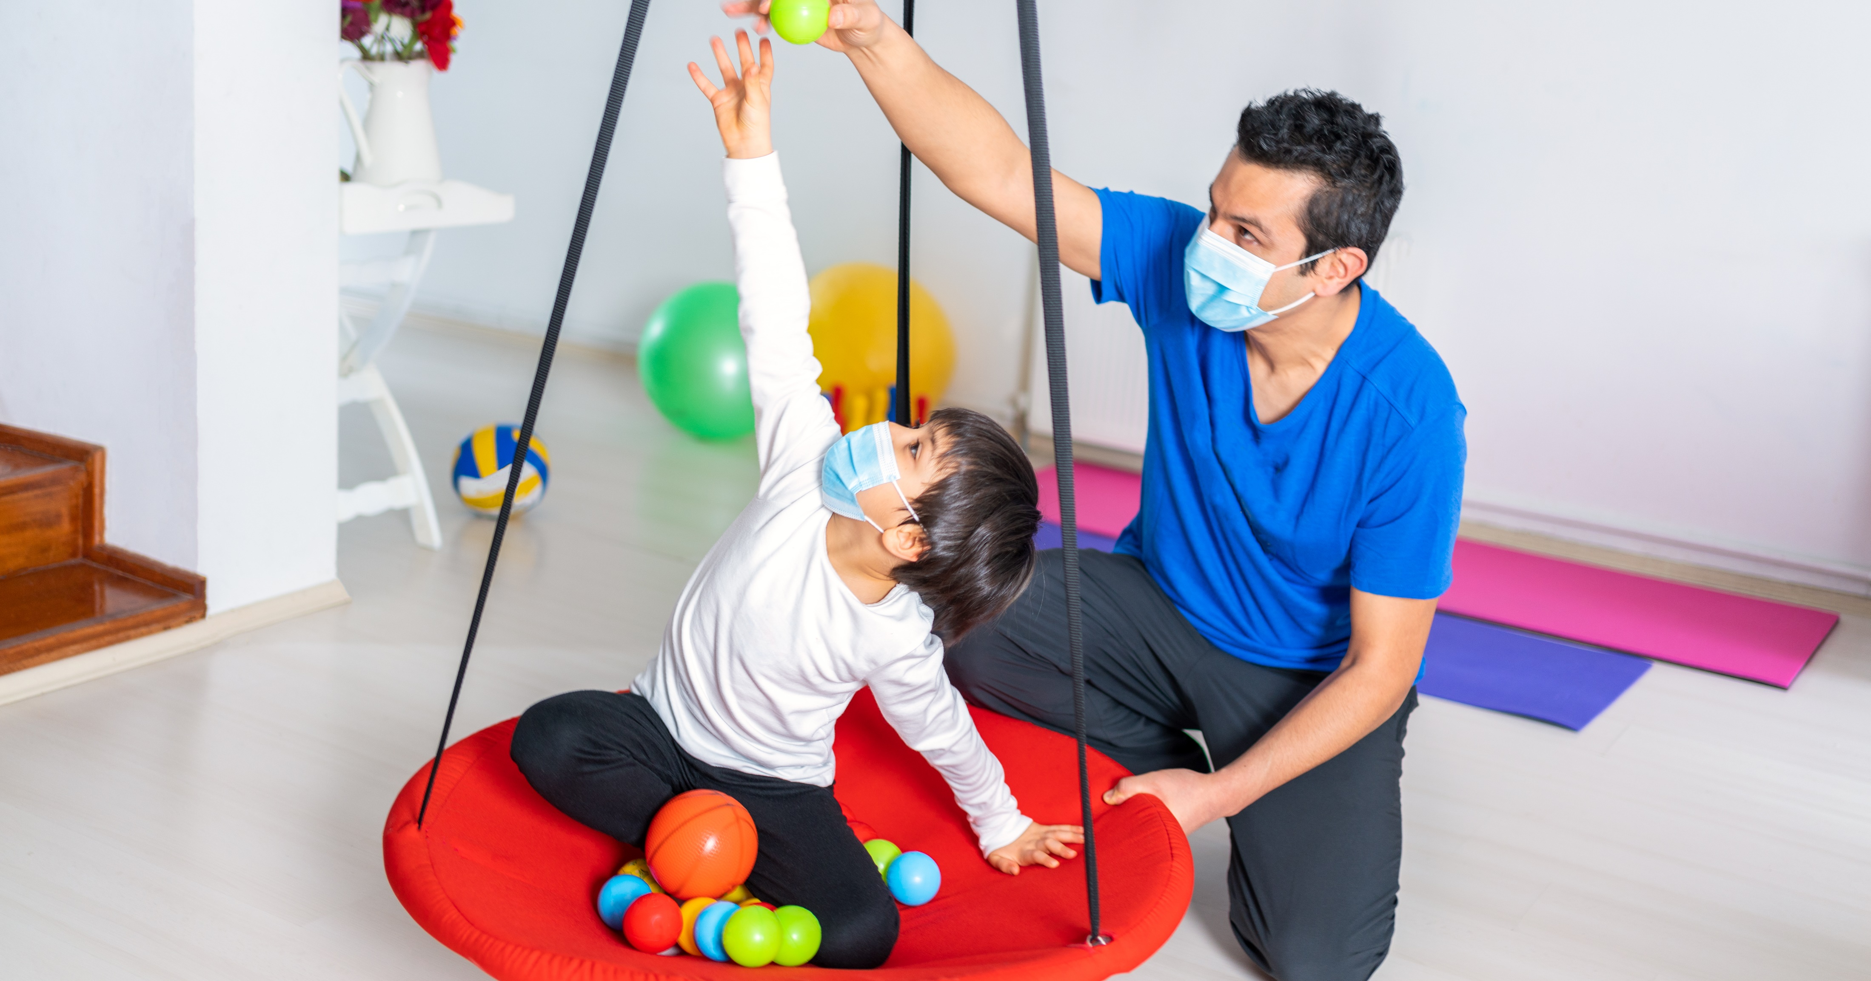
Toys and Games
Notes:
Toys and games including video games, virtual reality, and robotic devices – When you are playing video games, playing with toys, and playing games, you are moving! So, they can also be used to teach proper movement mechanics and help patients regain movement.

Slide 16
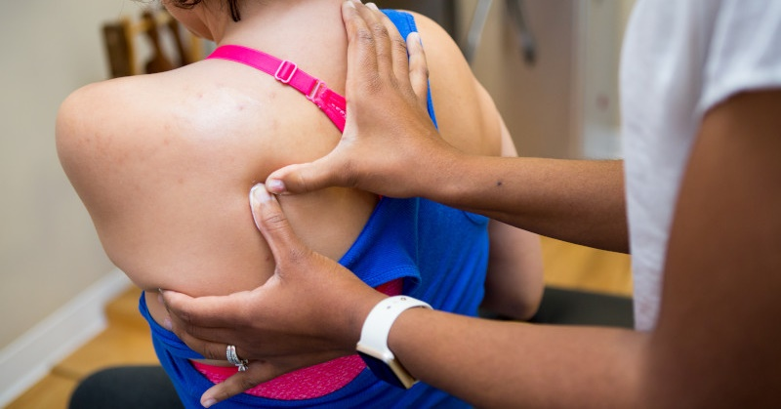
Manual Therapy
Notes:
Manual therapy and masssage – Physical therapy is a hands-on profession. PTs and PTAs are trained to locate muscles, joints, nerves, bones, and tendons through physical touch. PTs and PTAs can use massage, electrical stimulation, and other manual therapy techniques to treat patients.
Palpation
Hold your arm out and touch your upper arm (bicep). Now flex your arm, and make a muscle. Did you feel your muscle move? Does anyone know the name of this muscle? That’s your bicep muscle.
Now extend your arm again but this time feel the back of your arm (triceps). Now flex your arm again. Did you feel your muscle move? Anyone know the name of this muscle? That’s your triceps muscle.
Now touch the back of your lower leg (calf). Now flex your foot. Do you feel your muscle move? Anyone know the name of this muscle? That’s your gastrocnemius, or your calf muscle.

Slide 17
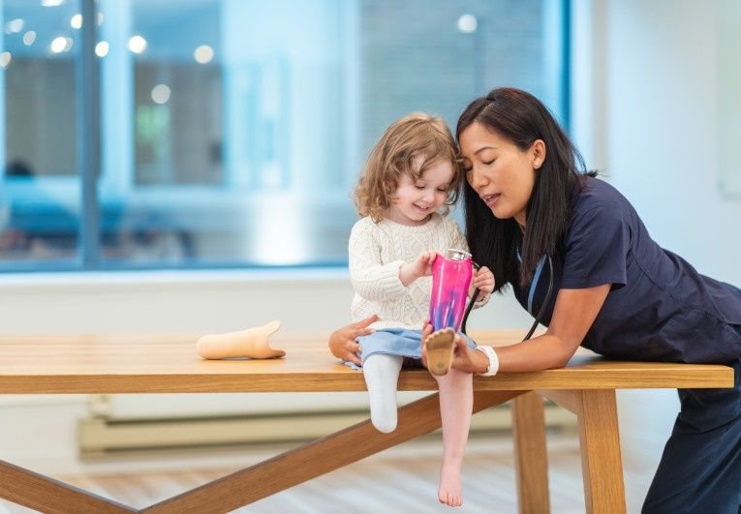
Remember…
Physical therapy helps people move!
Notes:
During this presentation, you have done quite a bit of movement:
Jumping.
Squatting.
Bending.
I want you to remember:
Movement is essential to life.
Physical therapy helps to keep people moving.
Break it down and have them repeat after you: Physical Therapy (pause) Moves (pause) Me (and have them point to themselves).
Then repeat all together: Physical Therapy Moves Me!

Slide 19
Thank You

